Slide 1

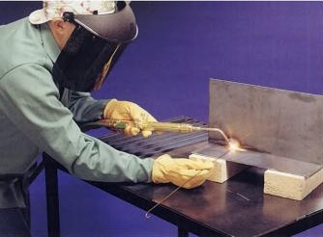
Thermo-Compression Welding
Hot Isostatic Pressure Welding
Explosion Welding
IC141
Even Semester February-June 2014
Lecture #14
Dr. Mohammad Talha
Asst. Professor
School of Engineering
Indian Institute of Technology Mandi
H.P., INDIA, 175 001
talha@iitmandi.ac.in

Slide 2
Thermo-Compression
Pressure
Heat
  Gas Flame
  Electrical
Atmosphere
  Ambient
  Inert Gas
  Pressure Chamber
Ball Bonding

Slide 3
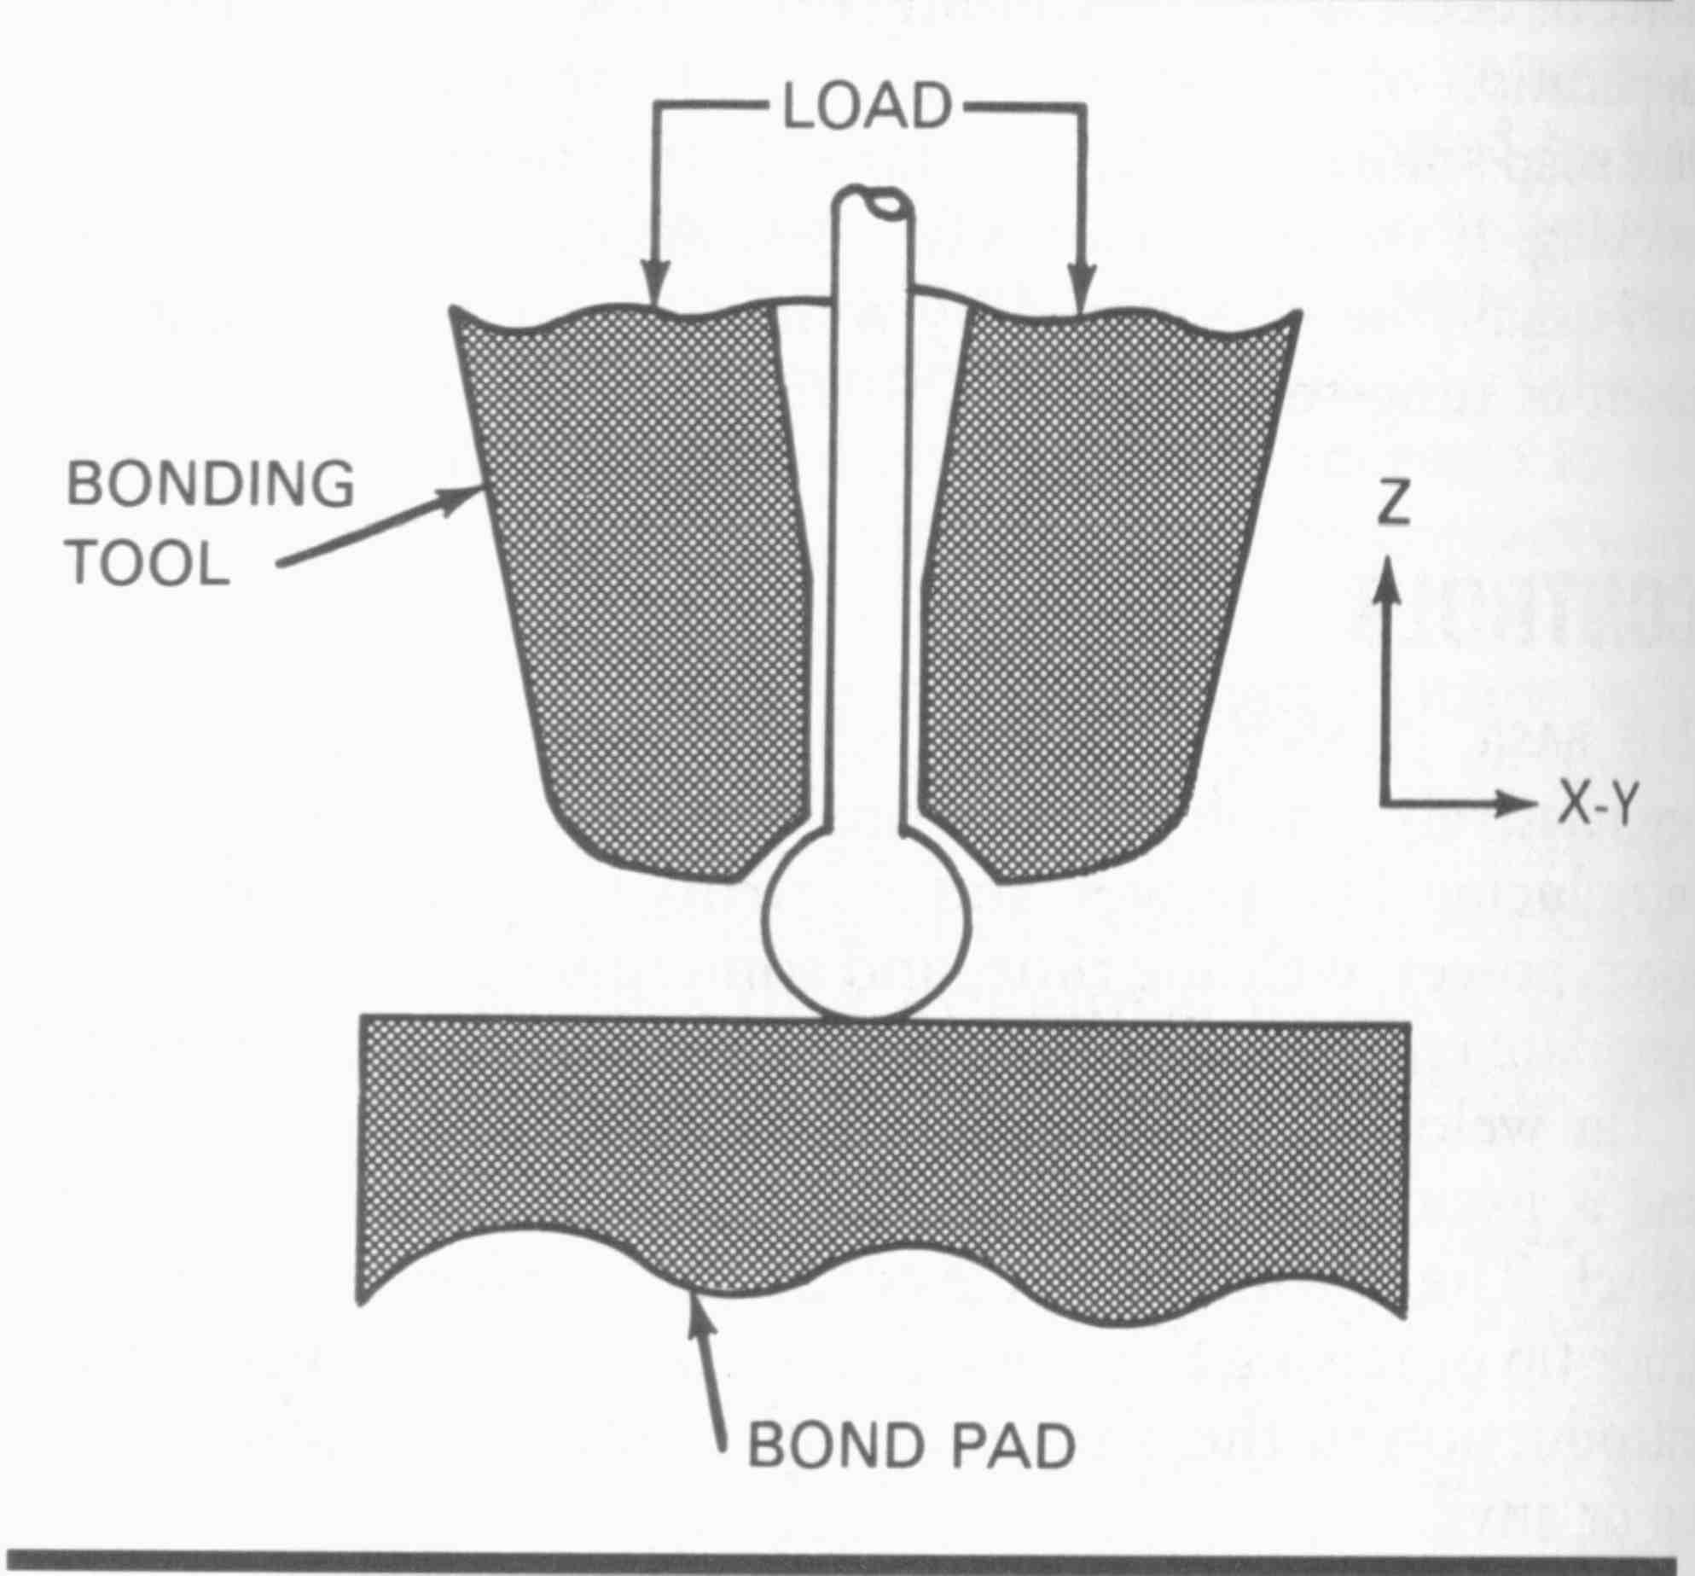
Ball Bonding
(Usually Used For Electrical Components)

Slide 4
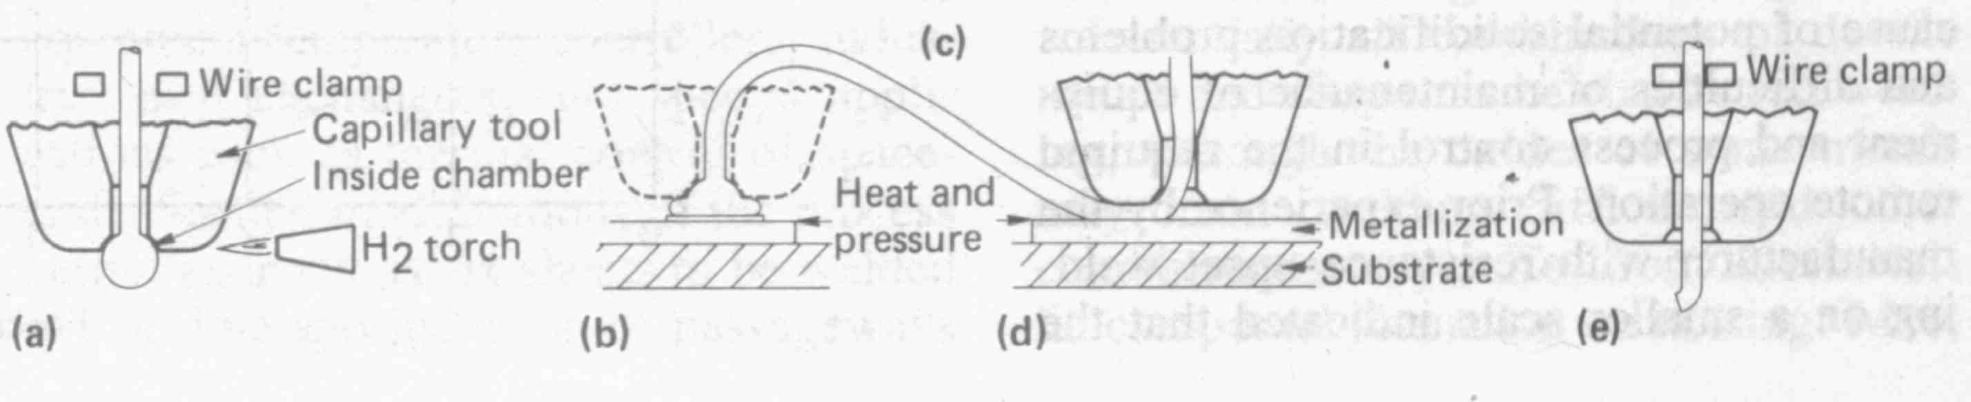
Metals Handbook, ASM, 1983

Slide 5
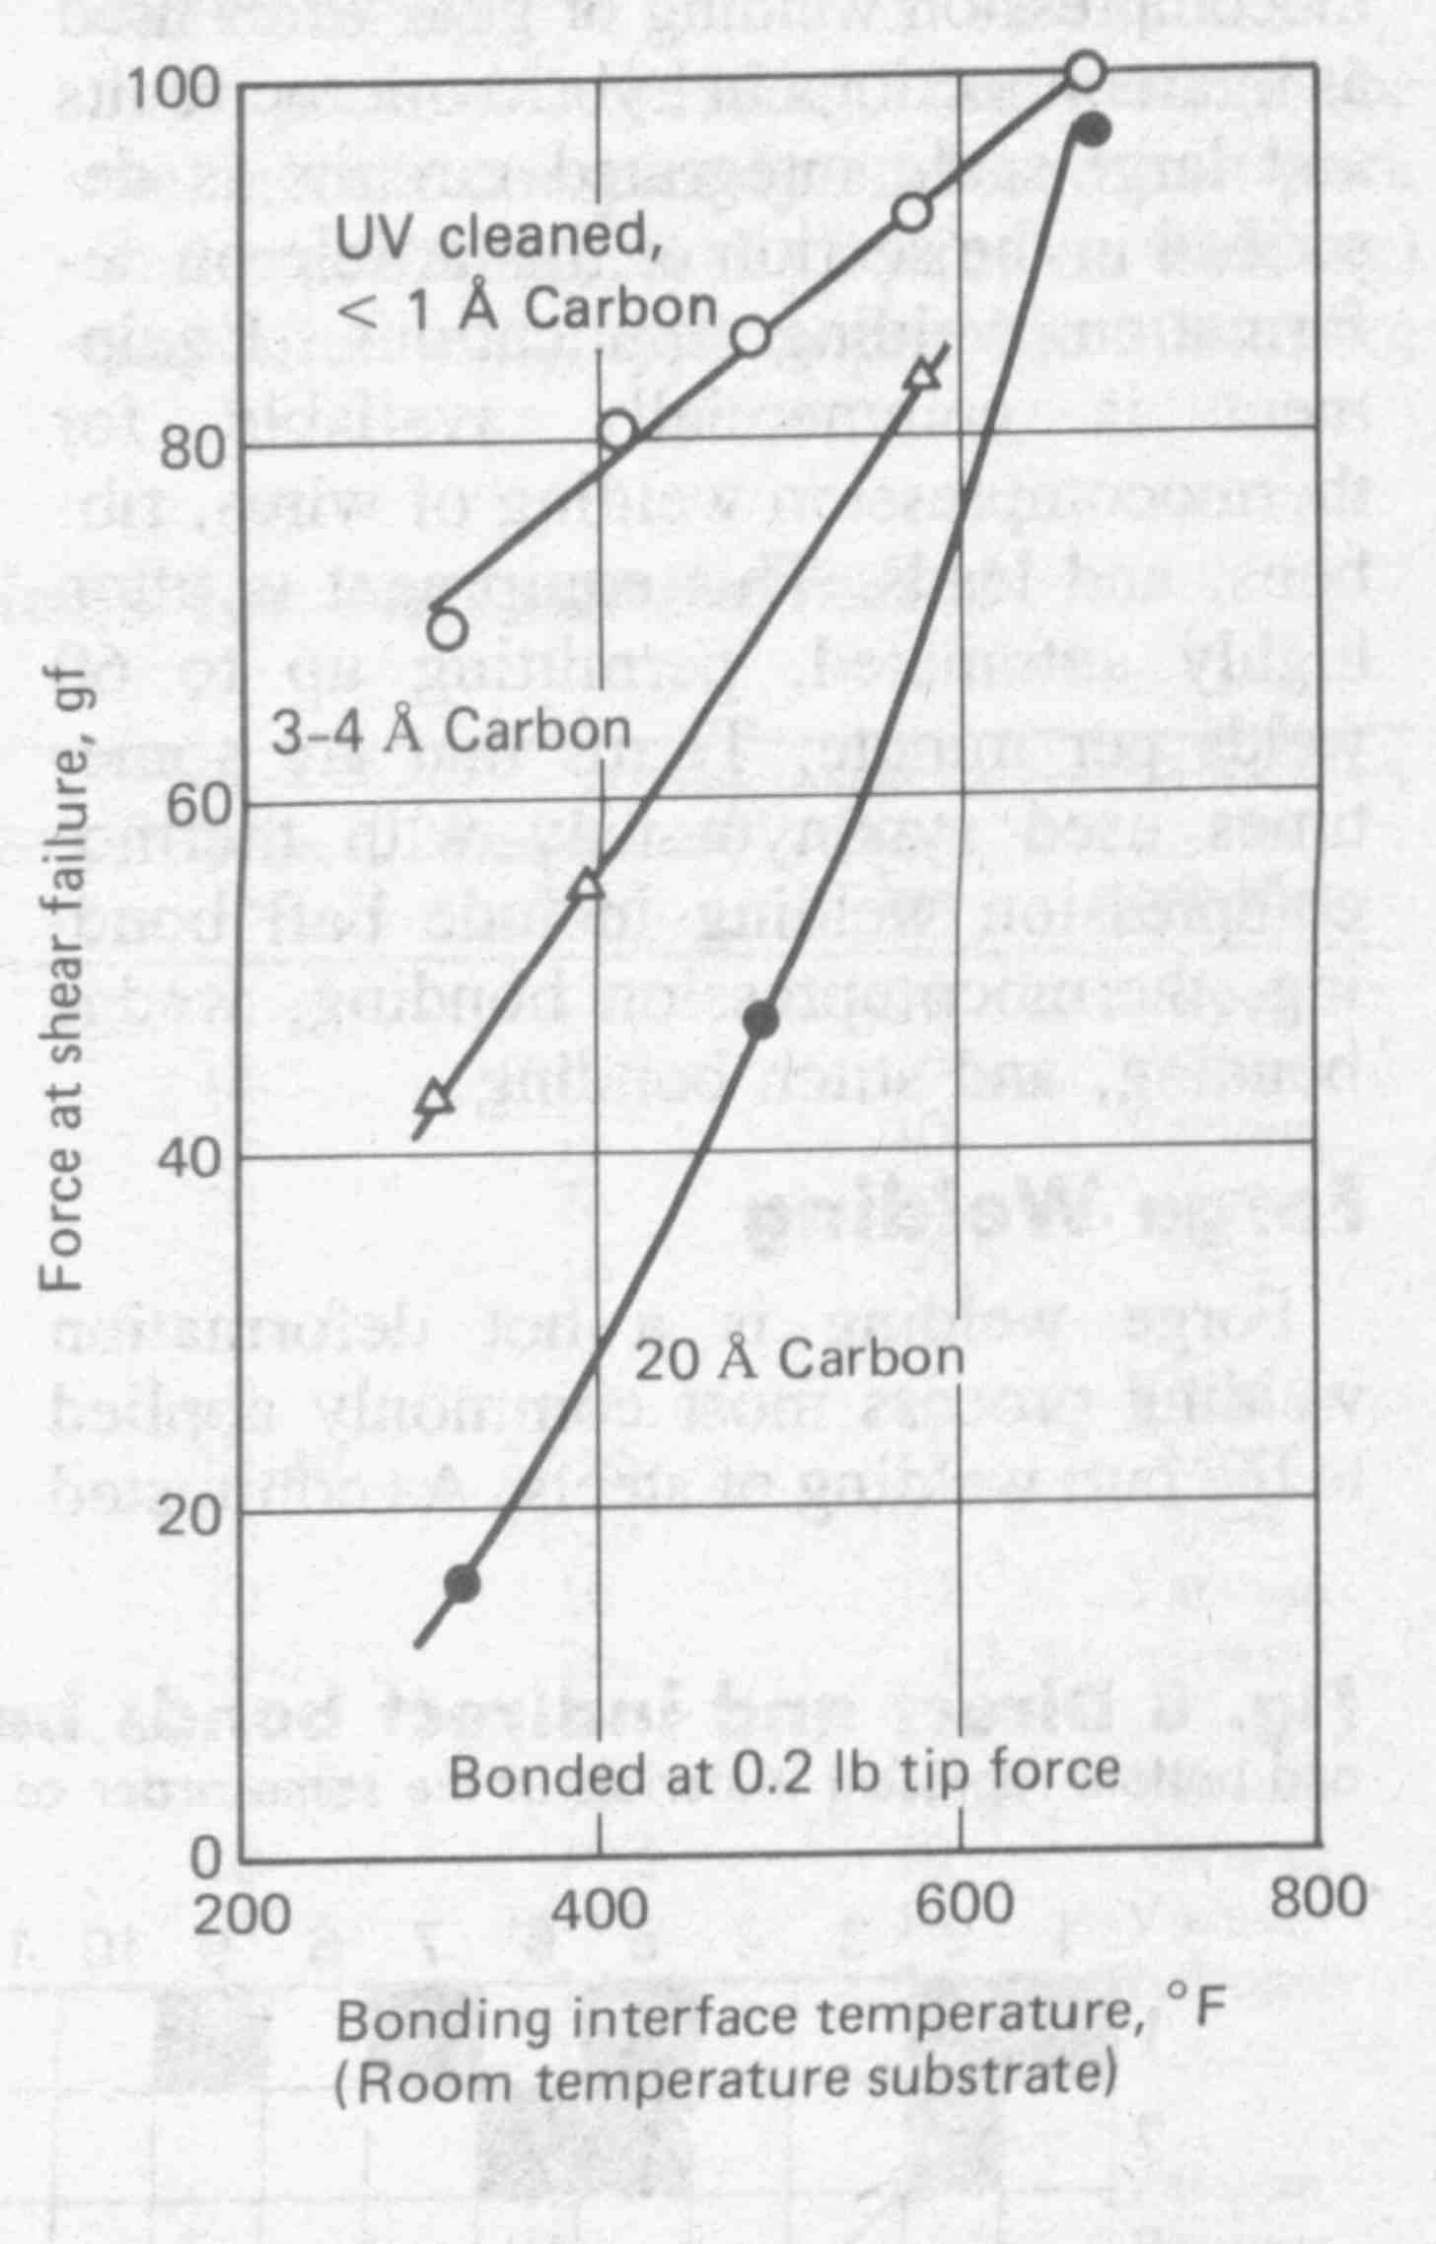
Effect of Surface Contaminants on Gold Ball Bonding
Metals Handbook, ASM, 1983

Slide 6
Thermo-Compression
Pressure
Heat
  Gas Flame
  Electrical
Atmosphere
  Ambient
  Inert Gas
  Pressure Chamber
Thermo-compression
Welding

Slide 8
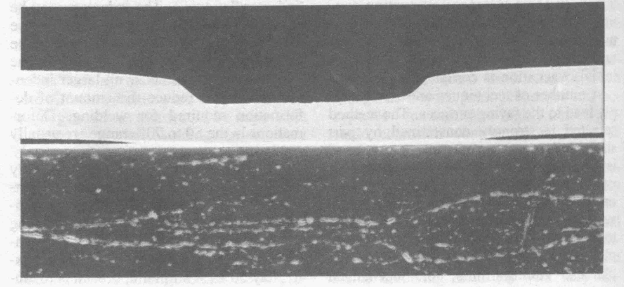
Metals Handbook, ASM, 1983

Slide 9
Thermo-Compression
Pressure
Heat
  Gas Flame
  Electrical
Atmosphere
  Ambient
  Inert Gas
  Pressure Chamber
Hot Isostatic Pressure
Welding

Slide 10
Definition of Hot Isostatic Pressure Welding
Pressure
chamber
Force
A solid-state welding process that produces coalescence of metals with heat and application of pressure sufficient to produce macro-deformation of the base metal.
seal layer
A
B
Heating circuit.
Schematic view of HIP

Slide 11
Principles of Hot Isostatic Pressure Welding
Materials to be welded are machined and placed in an evacuated chamber
Temperature is raised (by resistance heating or another method) and pressure is applied
Pressure and temperature cause joining through interfacial diffusion assisted processes
Vacuum
chamber
Force
Seal layer
A
B
Heating circuit.
Schematic view of HIP

Slide 12
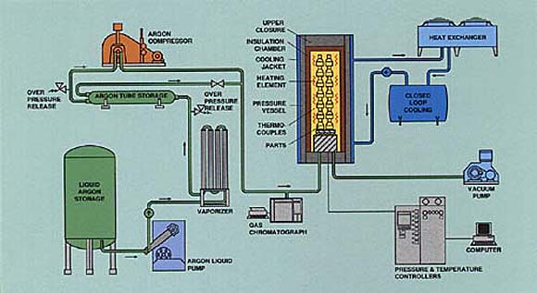
Pressure Technology, Inc.
415 Patricia Drive
Warminster, PA 18974
Notes:
Hot Isostatic Pressing (HIP), the simultaneous application of heat and high pressure, has become a standard production process in many industries. In the HIP unit a high temperature furnace is enclosed in a pressure vessel. Work pieces are heated and an inert gas, generally argon, applies uniform pressure. The temperature, pressure and process time are all controlled to achieve the optimum material properties. HIP is used for the bonding of dissimilar material, consolidation of plasma coatings, improvement of welds, processing soft and hard magnetic material and a variety of ceramic applications. In applications such as turbine engine rebuilding, HIP removes the effects of fatigue in components which have reached the end of their service life. The components can be rejuvenated for further service.

Slide 13
Hot Isostatic Pressing (HIP):
Simultaneous application of heat and high pressure.
In the HIP unit a high temperature furnace is enclosed in a pressure vessel. Work pieces are heated and an inert gas, generally argon, applies uniform pressure.
The temperature, pressure and process time are all controlled to achieve the optimum material properties.
HIP is used for the bonding of dissimilar material, consolidation of plasma coatings, improvement of welds, processing soft and hard magnetic material and a variety of ceramic applications.
In applications such as turbine engine rebuilding, HIP removes the effects of fatigue in components which have reached the end of their service life.

Slide 14
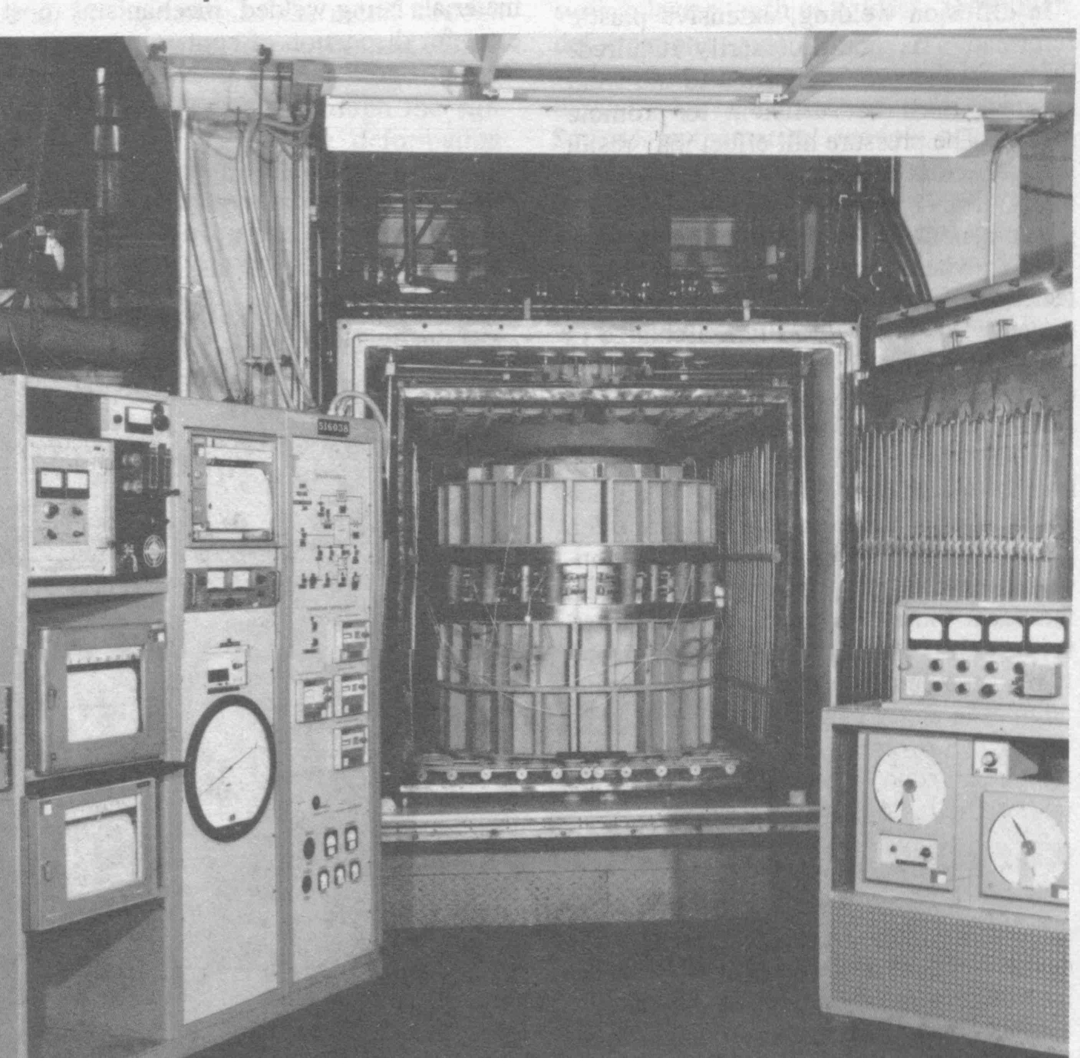
Metals Handbook, ASM, 1983

Slide 15
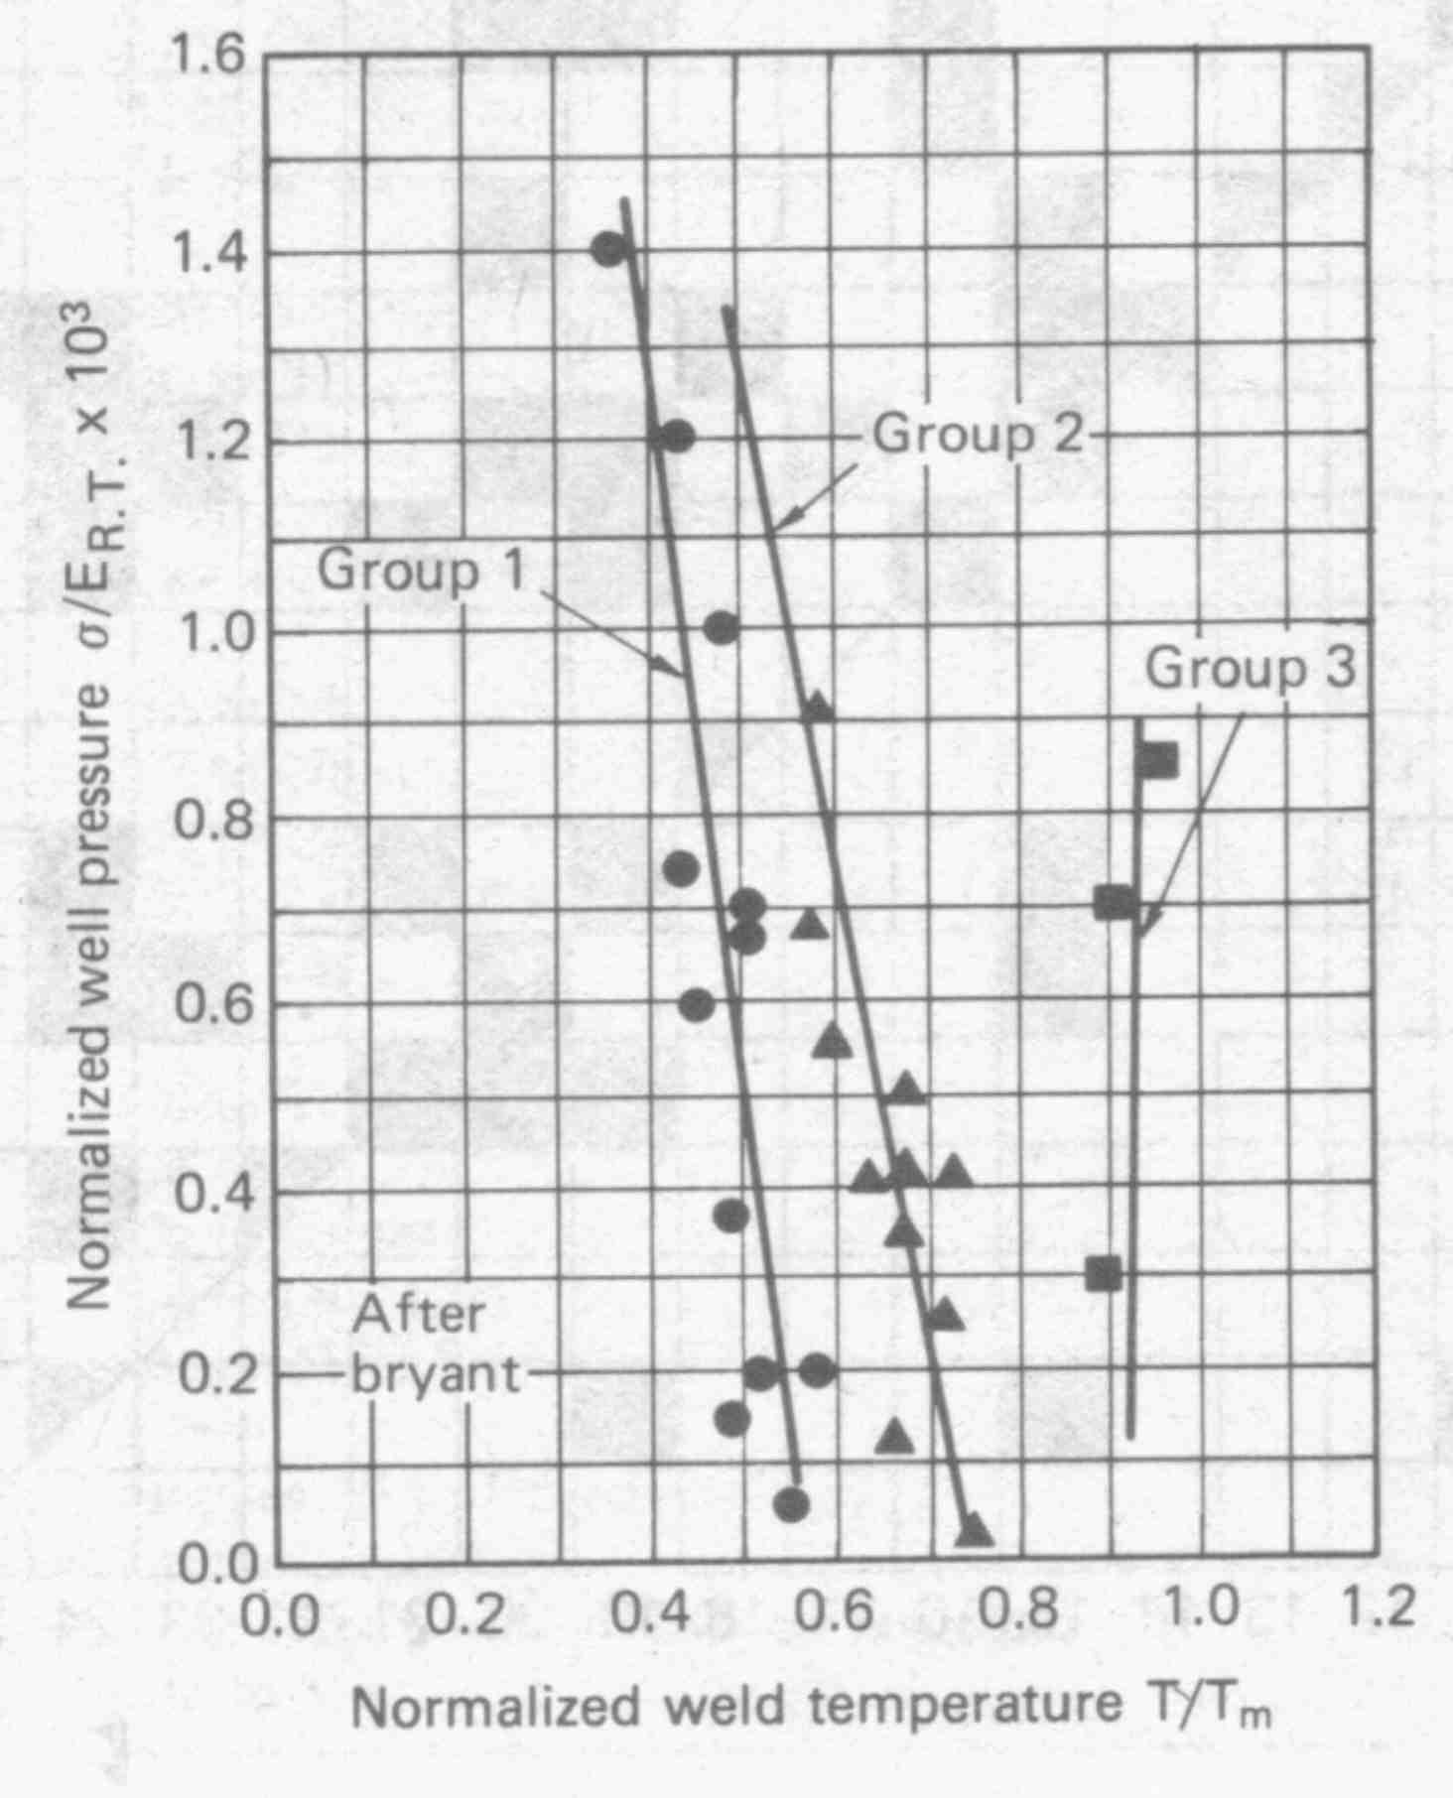
Depending on Material, Temperatures of 1/2 to 0.9
of the Melting Temperatures are used
Metals Handbook, ASM, 1983

Slide 16
Applications of Hot Isostatic Pressure Welding
Nuclear reactor components.
Gas turbine components
Special materials joining ( i.e., 304 stainless steel to TD nickel, 1018 steel to Hastelloy).
Composite tube-truss structures.

Slide 17
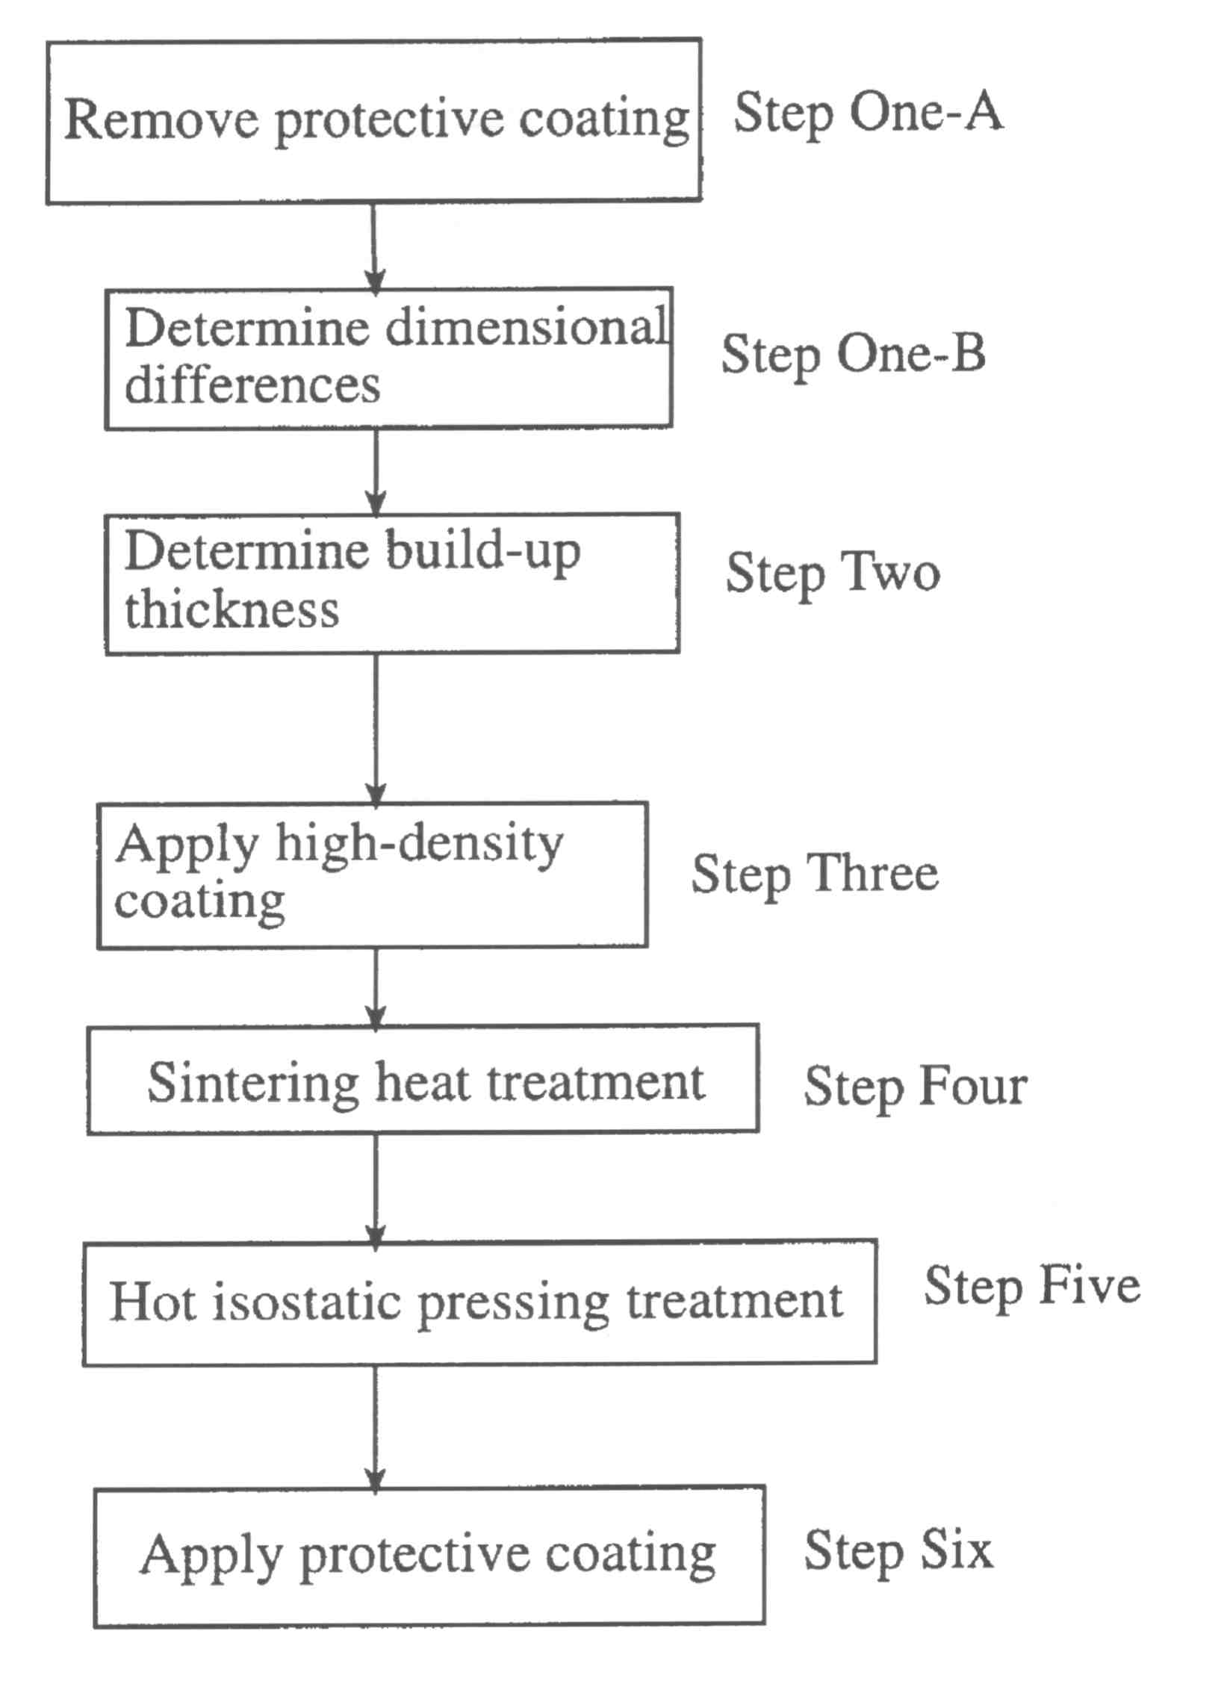
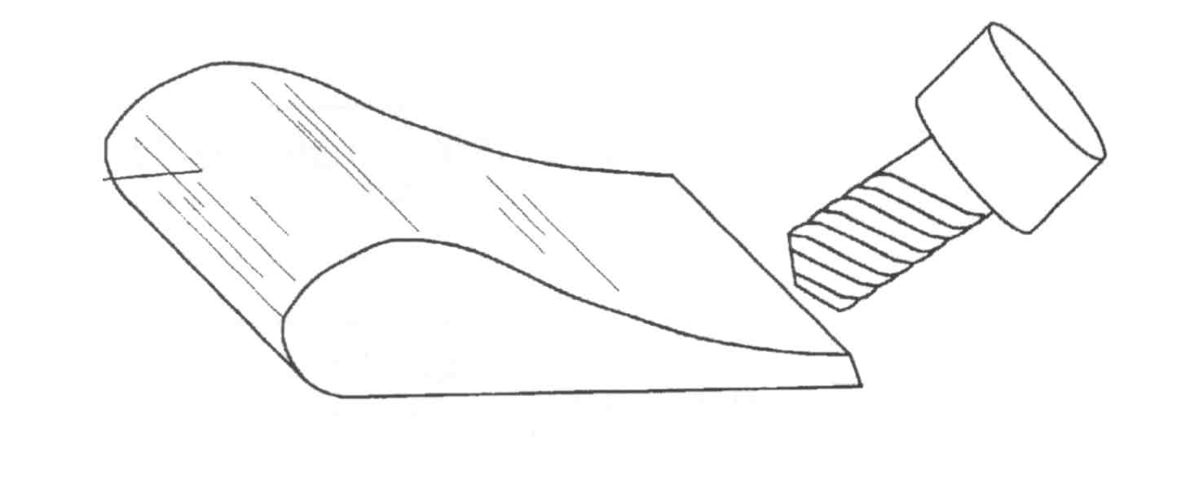
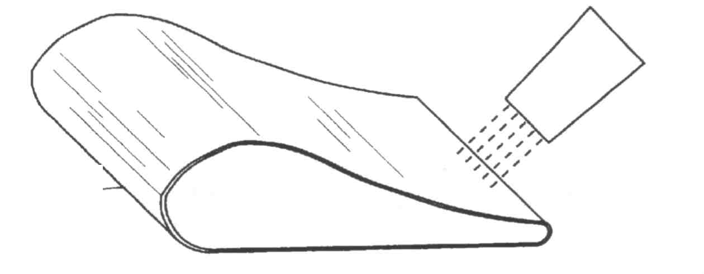
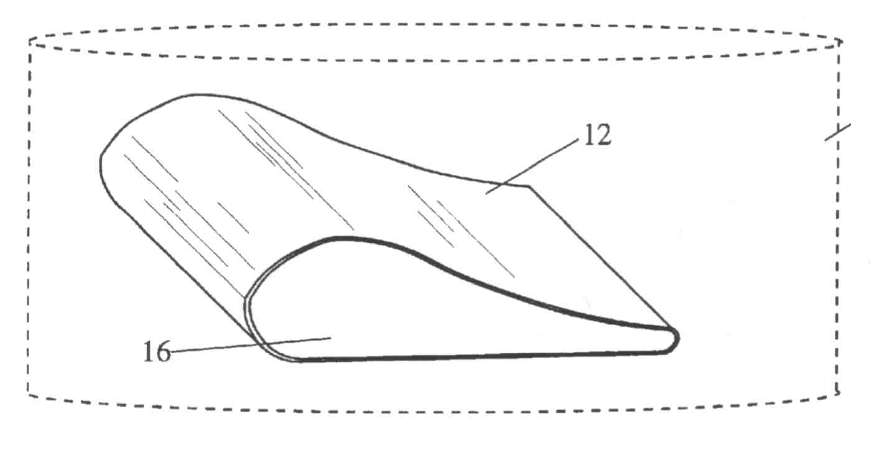
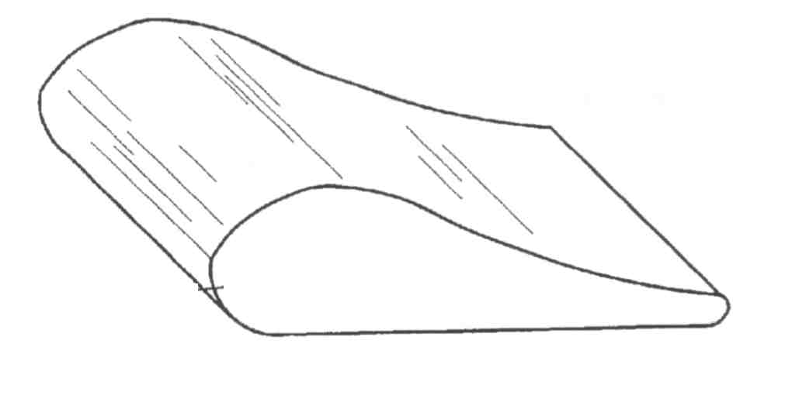
Arnold, J “Method for Repairing and Reclassifying Gas Turbine Engine Airfoil Parts” US Patent 6,049,978, Apr 18, 2000
Notes:
This slide represents a method for repairing gas turbine engine airfoil parts. The dimensional differences between pre-repaired and desired turbine engine airfoil parts are determined. A buildup thickness of coating material is determined and a high density spray coating material capable of diffusion bonding is applied. Hot isostatic pressing process is performed to obtain a post-repair turbine with diffusion bonded repair material.

Slide 18
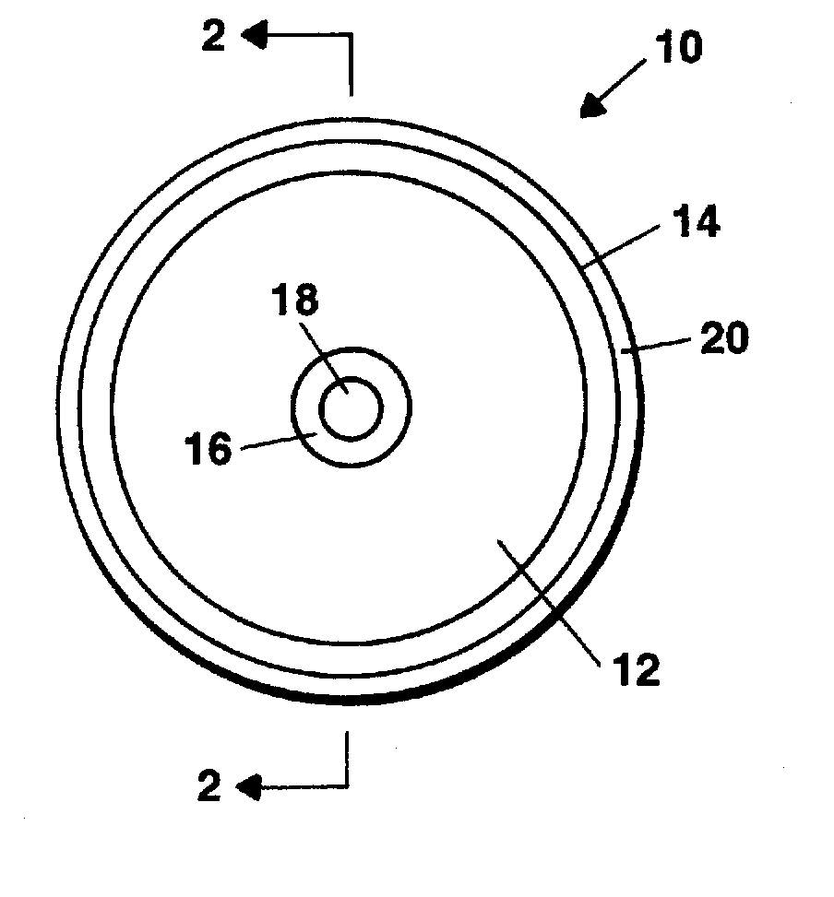
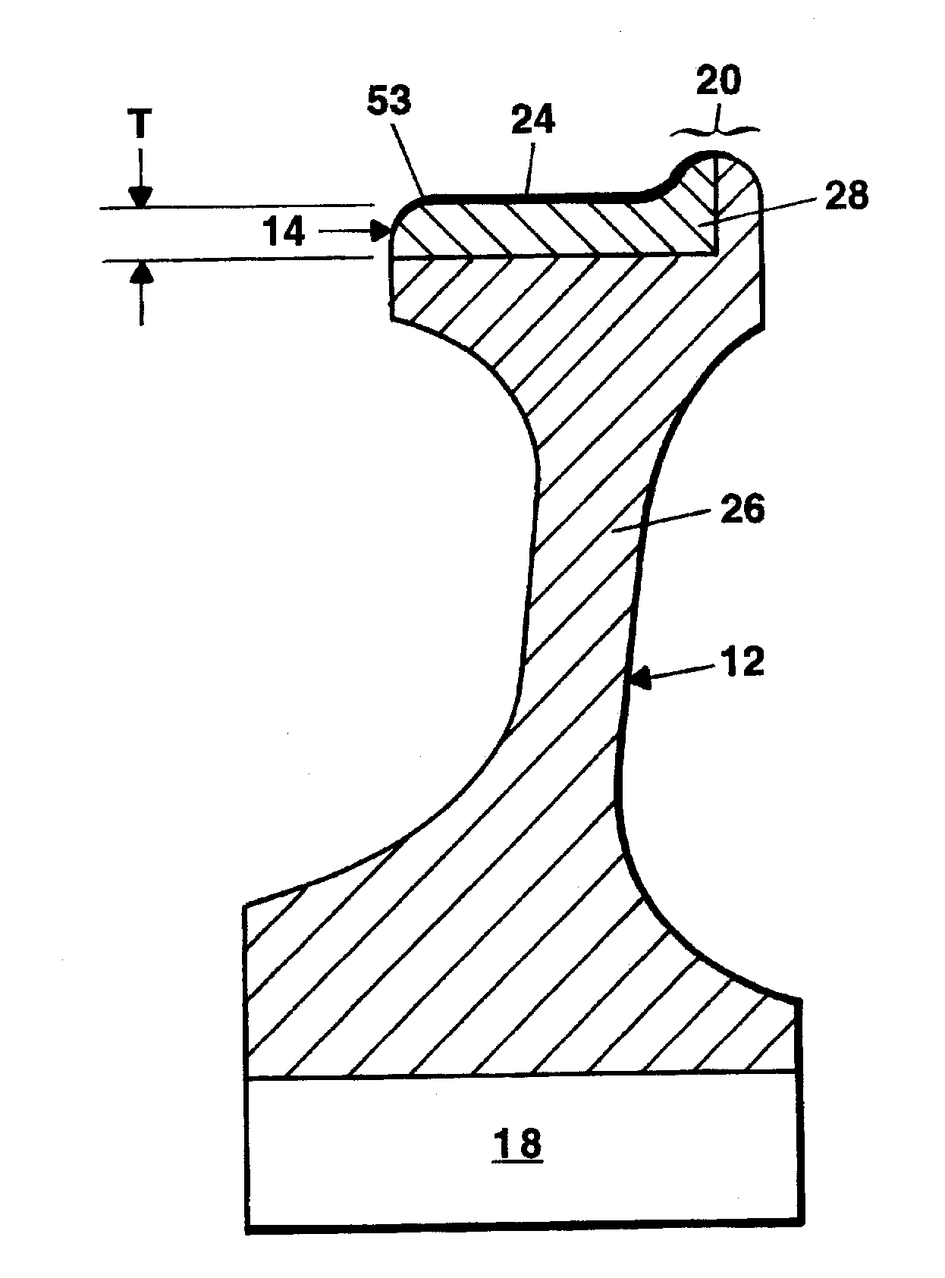
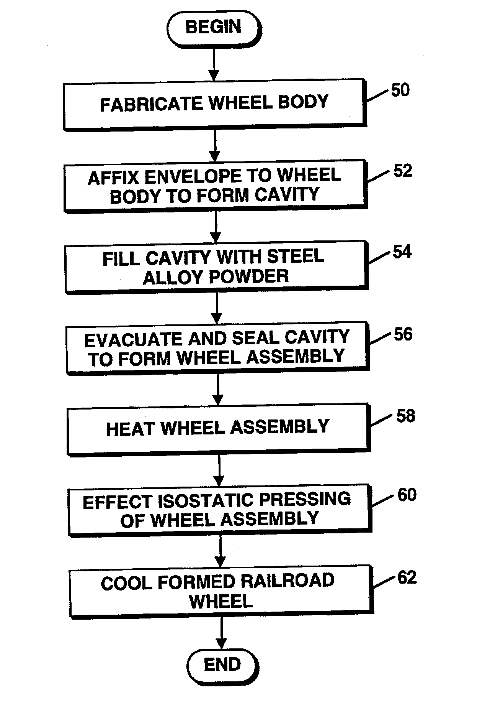
Dual Material
Railroad Wheel
Powders containing stainless steel, nickel alloys, tool steels and cobalt make coatings with improved traction for locomotives
Runkle, J. “Dual Alloy Railroad Wheel”, Patent 6,073,346 Jun 13, 2000
Notes:
Hot isostatic pressing of powders filling the cavity formed between the wheel body and the envelope form a bonded power metallurgy compact whose properties have high traction, useful for locomotive wheels pulling great loads.

Slide 19
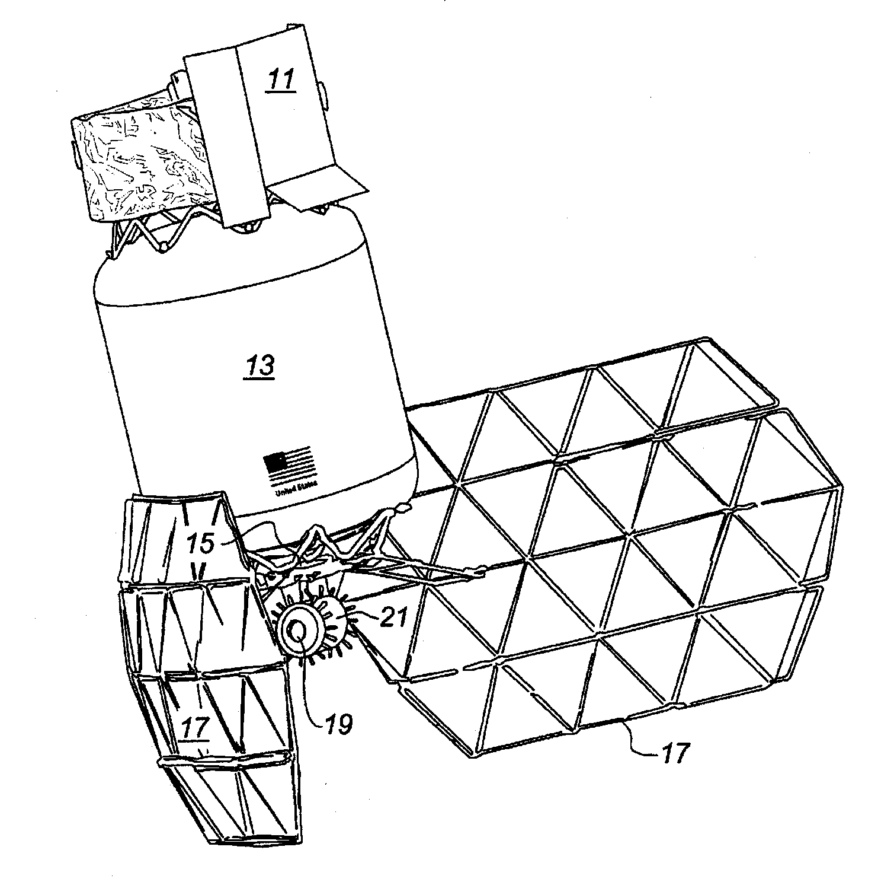
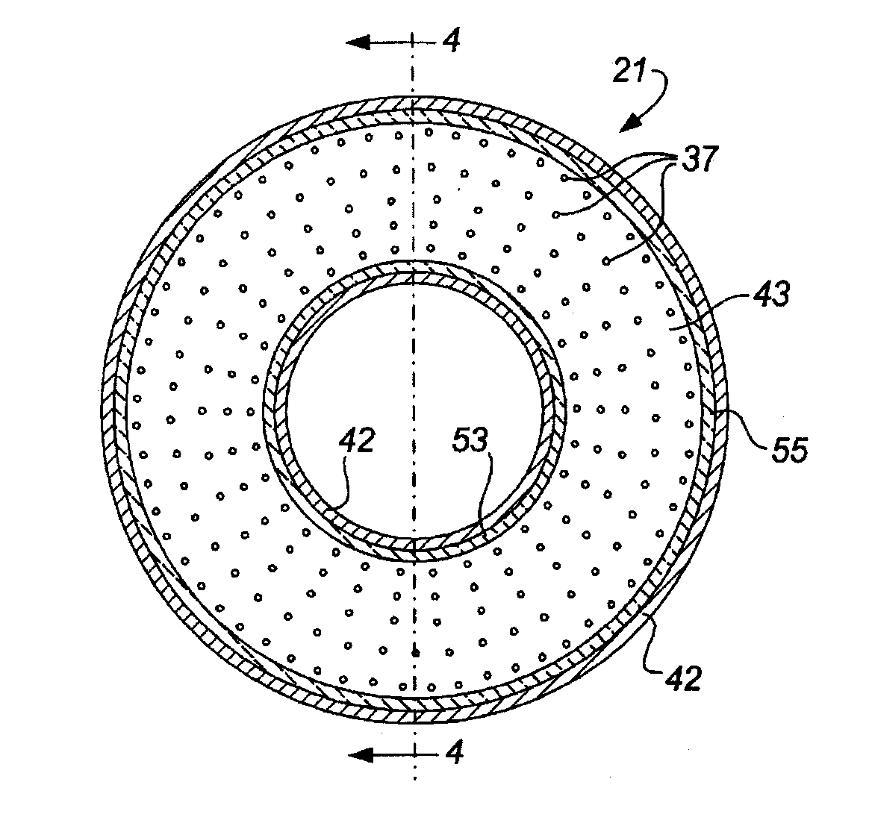
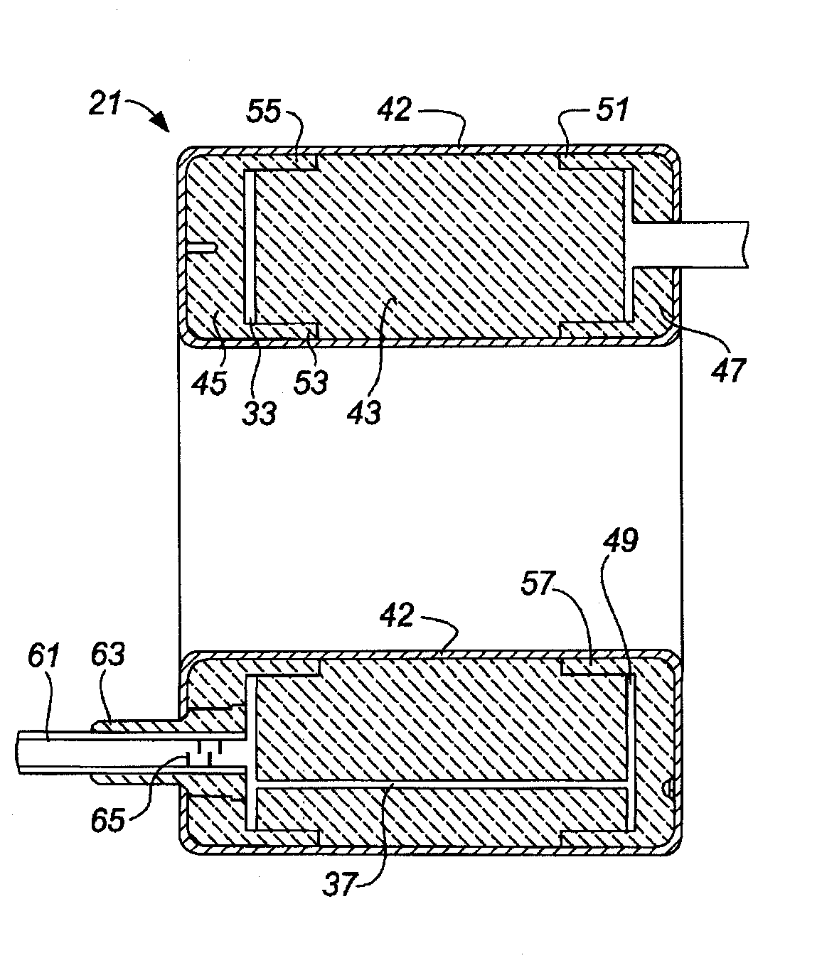
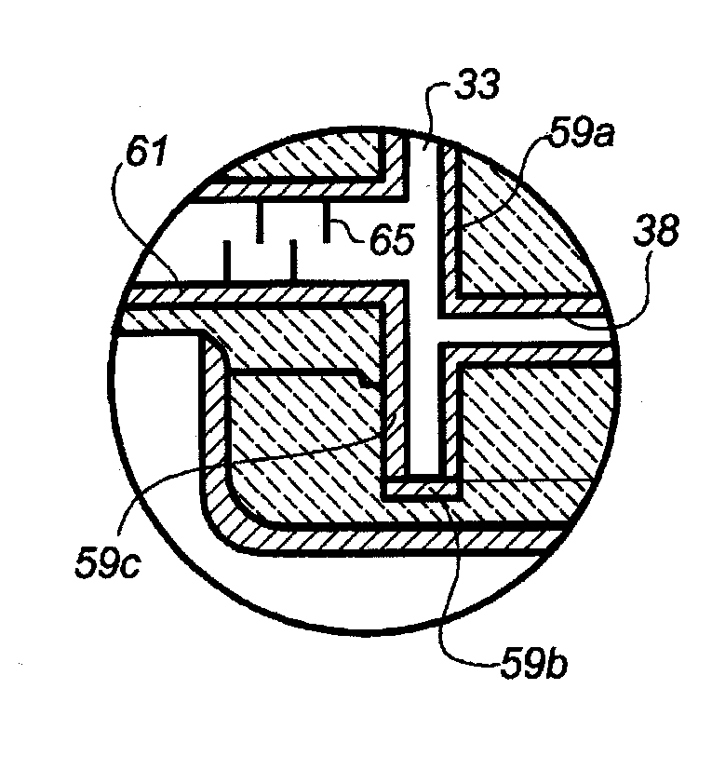
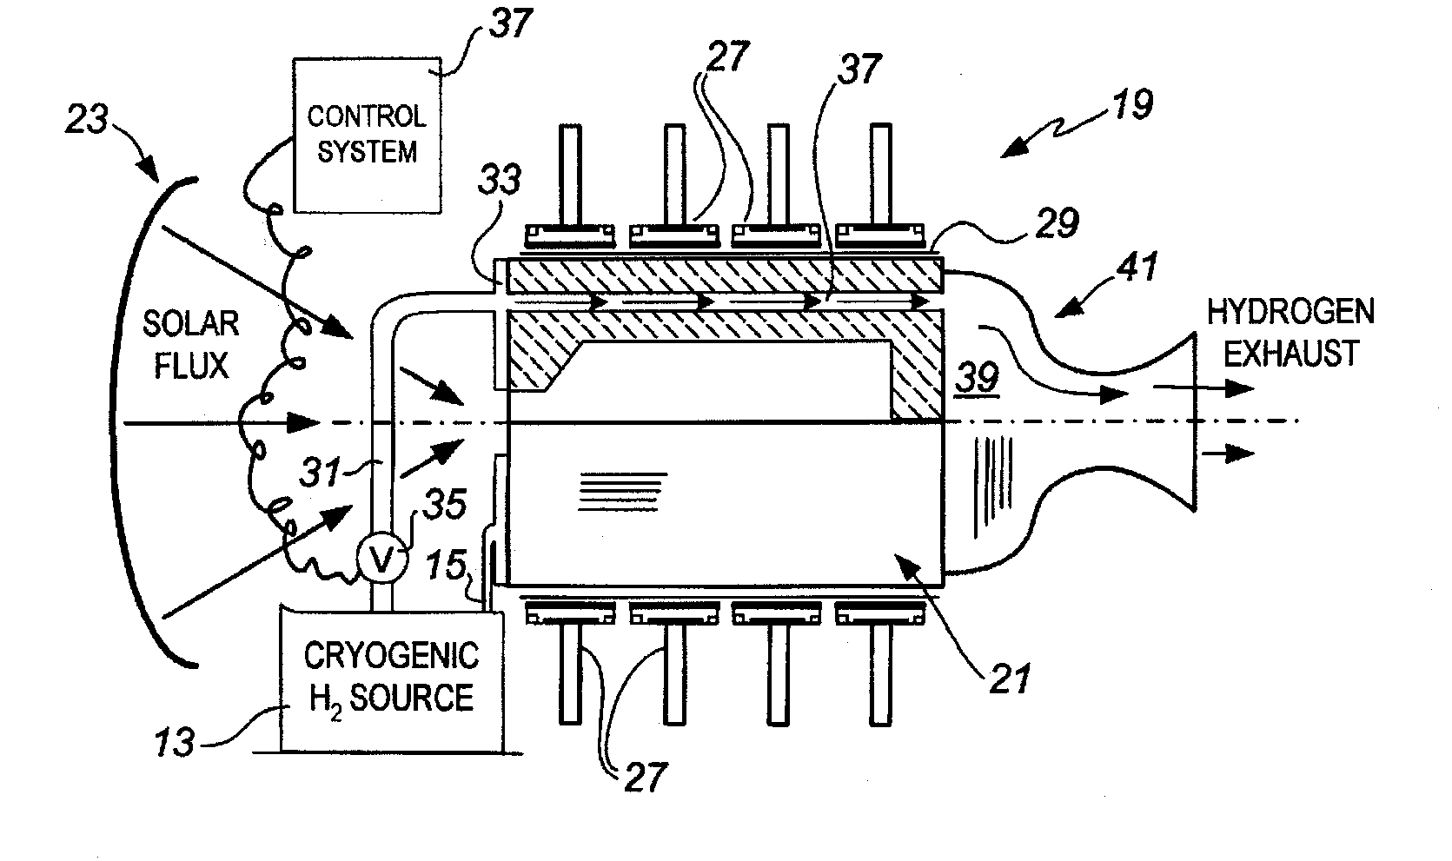
Hydrogen Space Engine
Solar Energy Reflects
On Engine (graphite core)
Graphite Core
With numerous
passage holes
Each passage lined with Rhenium
To protect graphite from hydrogen
HIP welded
Horner, M, Streckert, H, “Refractroy Heat Transfer Module”, Patent 6,065,284 May 23, 2000
Notes:
This device is for efficiently transferring heat from concentrated solar flux to an interior surface of an annular structure having a plurality of parallel passageways through which hydrogen gas flows an is heated to a high temperature to serve as a propellant for a space engine. A graphite core is solar heated and transfers that to a stream of hydrogen which is used as the propellant. Each of the numerous passageways through the graphite core is lined with rhenium sheet to protect the graphite. The lining is performed by Hot isostatic pressing welding.

Slide 20
EXPLOSION WELDING

Slide 21
Definition of Explosion Welding
A solid-state welding process that produces coalescence by high velocity interaction of the work pieces produced by a controlled detonation.
Detonator
Explosive
standoff
distance
prime
component
Base
component
Component arrangement
for explosion welding

Slide 22
Principles of Explosion Welding
Welding arrangement consists of three components -
  Base component
  Prime component
  Explosive.
Base component remains stationary, supported by anvil.
Detonator
Explosive
prime
component
Base
component
Component arrangement
for explosion welding
Notes:
In explosive welding, the prime component is propelled toward the base component by an explosive charge (see figure above). The base component is supported on an anvil. The explosion deforms the prime component and accelerates it across the standoff distance between the components.

Slide 23
Principles of Explosion Welding
Prime component is placed either parallel or at an angle to the base.
Explosive is distributed over top surface of prime component.
Upon detonation, prime component collides with base component to complete welding.
Detonation
Prime
component
Weld
Jet
Base
component
Action between components
during explosion welding.
Notes:
The collision between the components produces an interaction that produces local melting, vaporization, and possibly plasma formation. Most of the liquid and vapor is expelled from the joint by a strong jet action at the interaction point. The resulting weld has a wavy appearance.

Slide 24
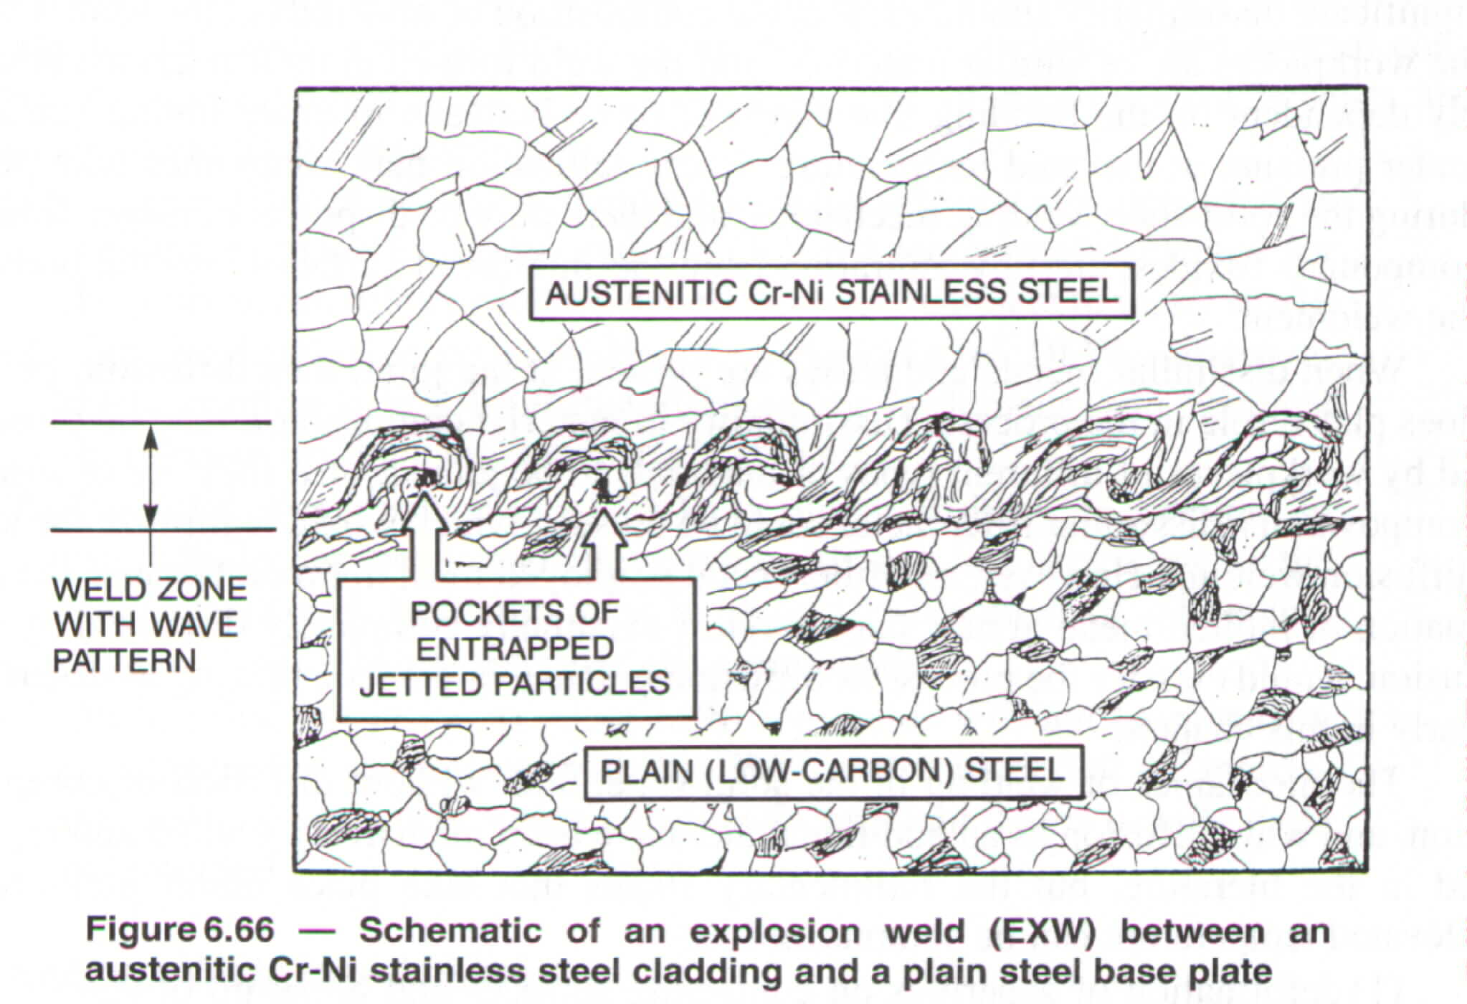
Linnert, Welding Metallurgy,
AWS, 1994

Slide 25
Process Variables and Controls
Explosive Pressure
Variables
Collision Velocity
Collision Angle
Prime Component Velocity
These are Controlled By:
Component Mass
Explosive Charge
Initial Geometry - Standoff Distance or Angle
V = charge velocity
Notes:
The major variables in the process include collision velocity, collision angle, and prime component velocity. These variables are in turn controlled by the initial geometry of the welding configuration, the mass of the prime component, and the explosive charge.

Slide 26
Explosives Used for Welding
High Velocity 14750-25000 ft/s
Trinitrotoluene (TNT)
Cyclotrimethylenetrinitramine (RDX)
Pentaerythritol tetranitrate (PETN)
Composition B
Composition C4
Primacord
Low to Medium Velocity 4900-14750 ft/s
Ammonium nitrate
Ammonium nitrate sensitized with fuel oil
Ammonium perchlorate
Amatol
Amatol and sodatol diluted with rock salt to 30 to 35%
Dynamites
Nitroguanidine
Dilute PETN

Slide 27
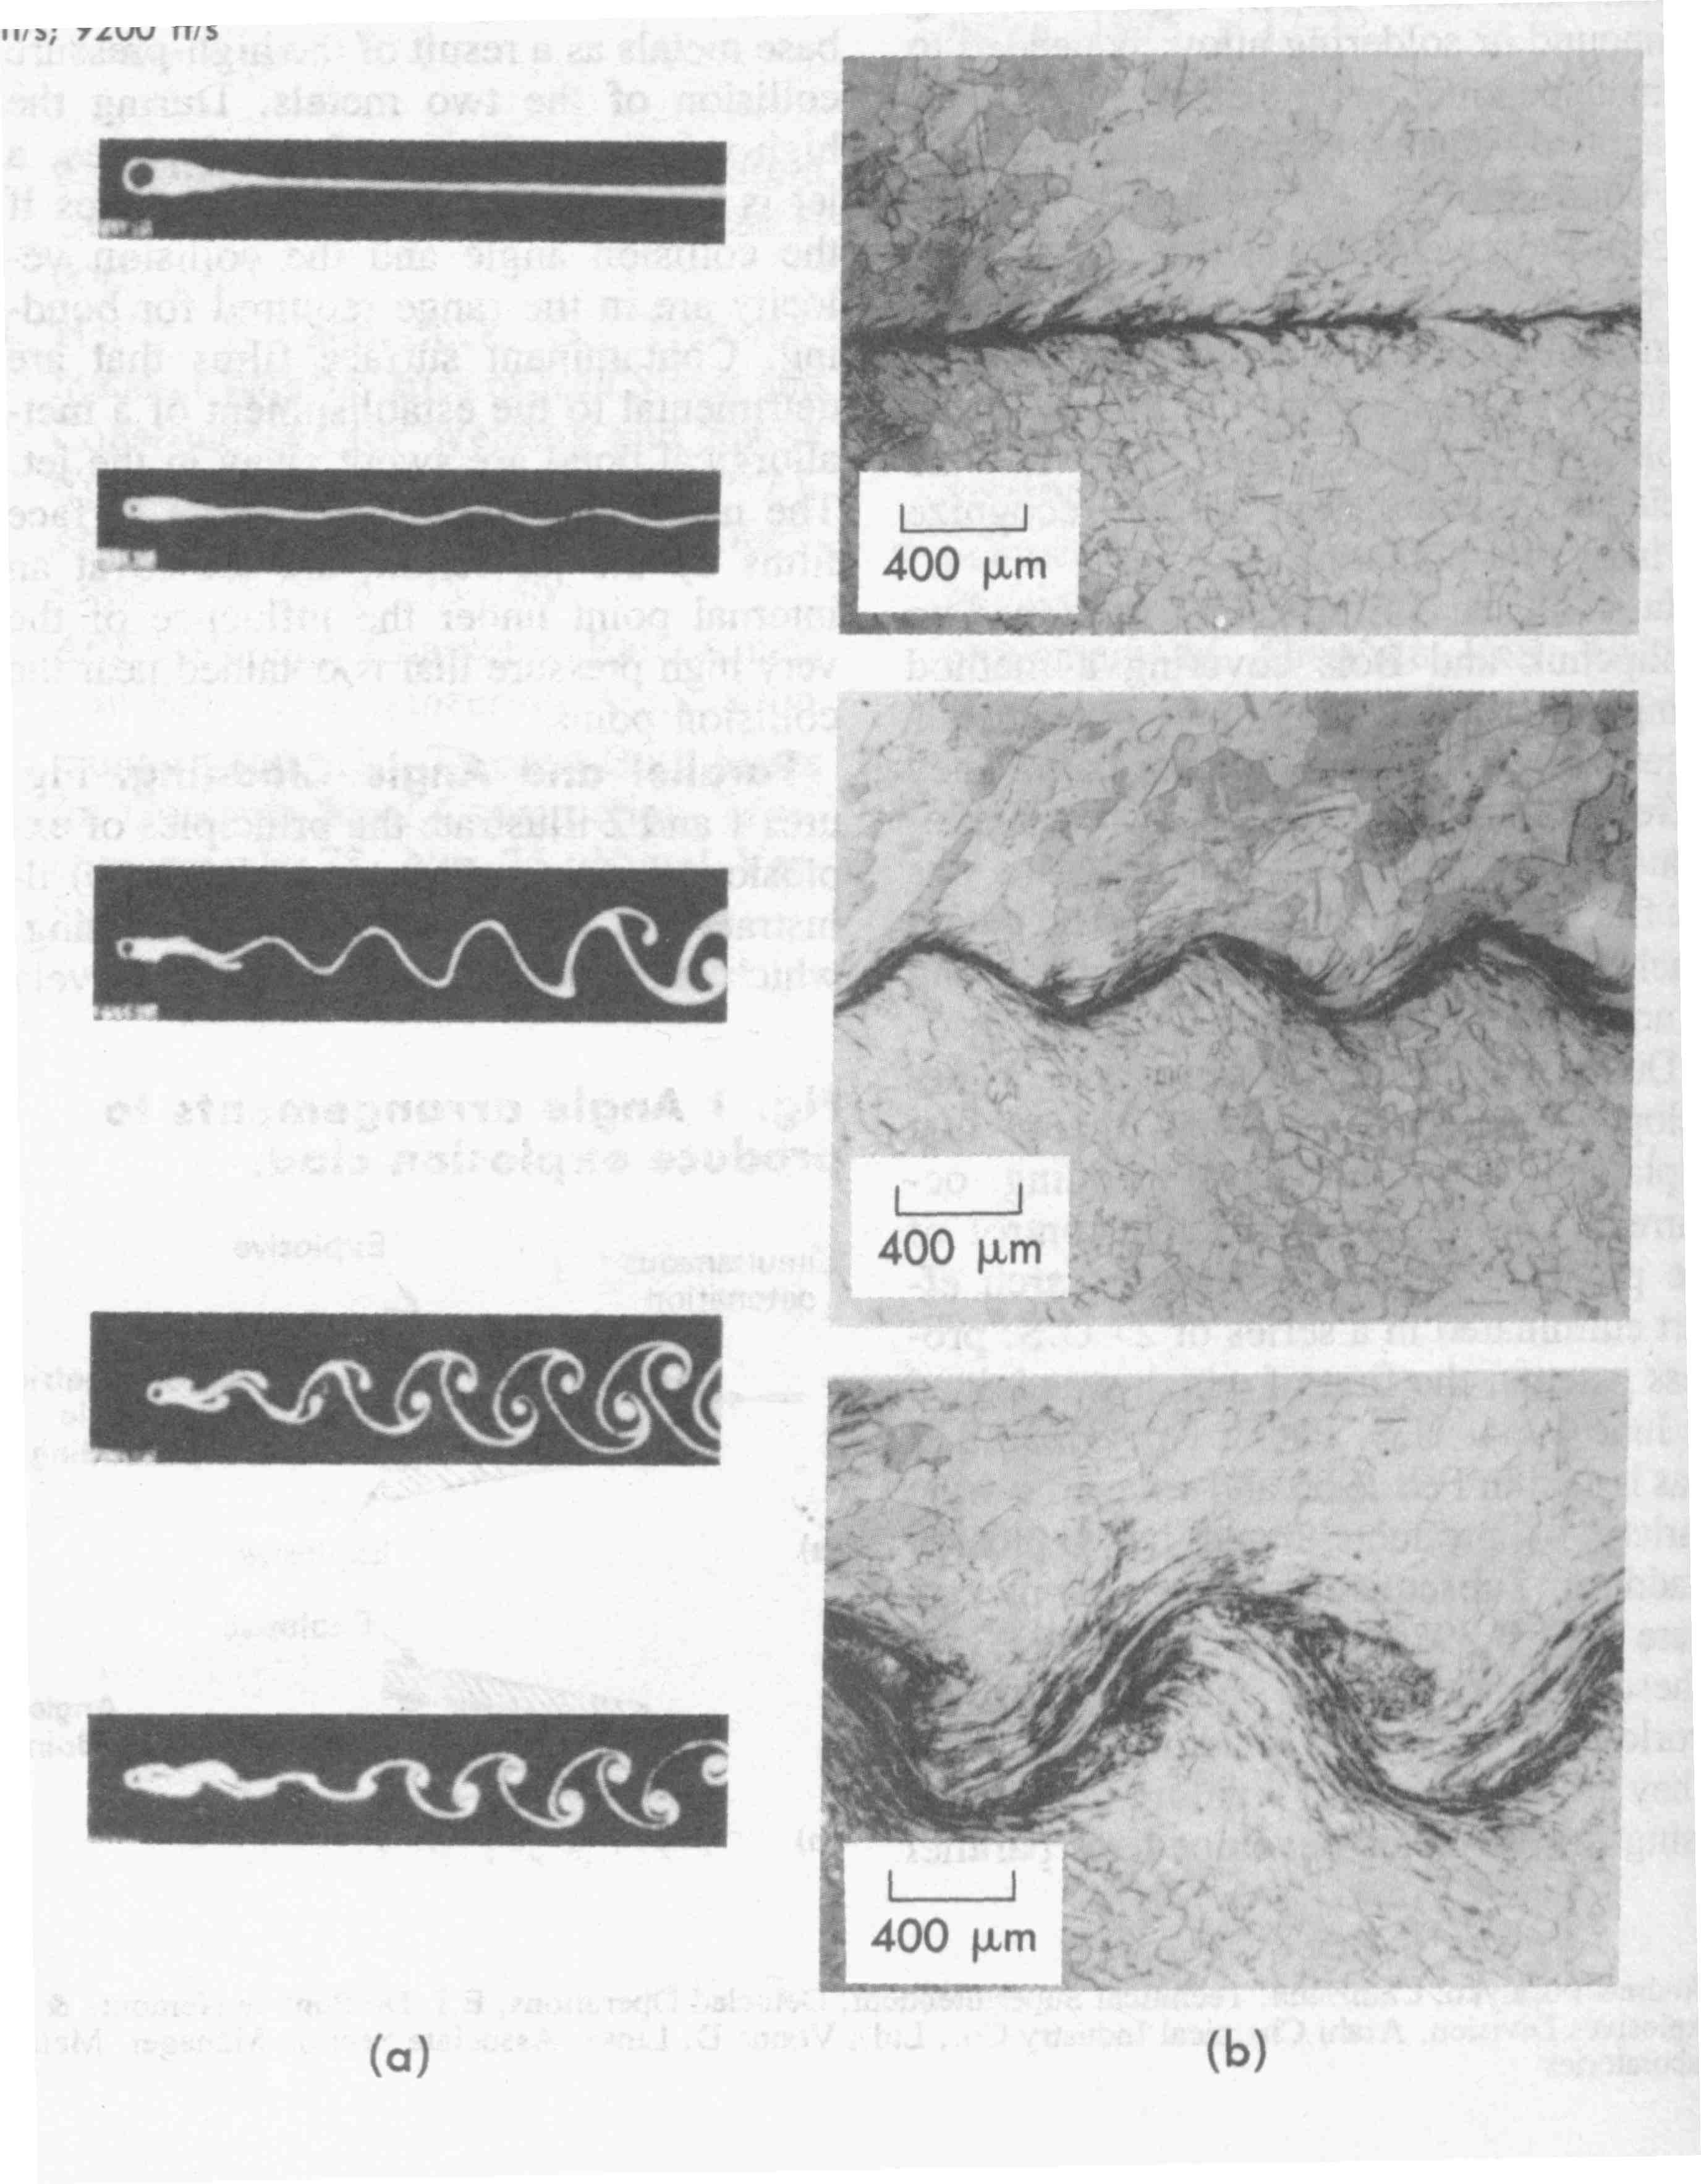
Effect of Velocity on Explosion Weld Geometry
Metals Handbook, ASM, 1983

Slide 28
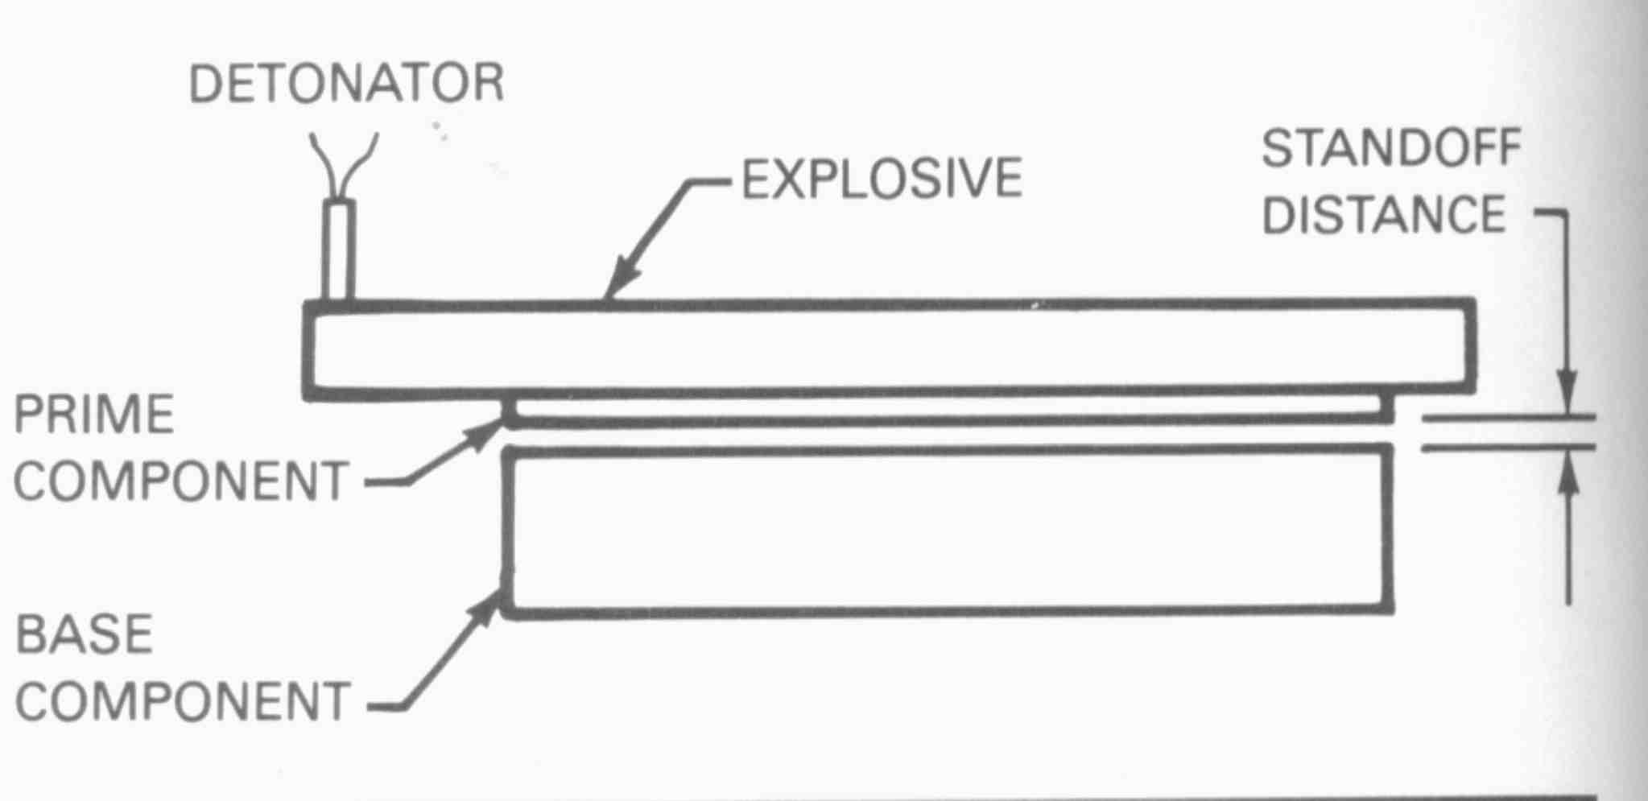
In Parallel Arrangement
Standoff = 1/2 to 1.0 times clad
Courtesy AWS handbook

Slide 29
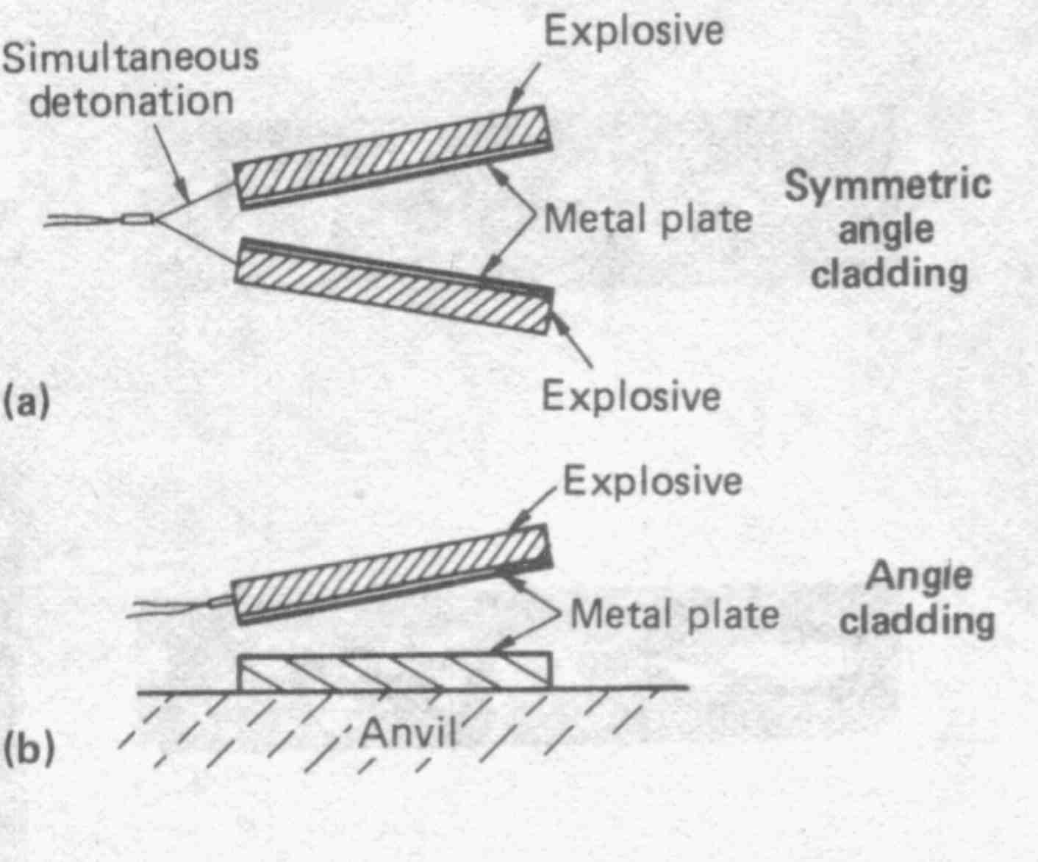
In Angular Arrangement
Angle = 1 to 8 Degrees
Metals Handbook, ASM, 1983

Slide 30
Wave Height
Larger Standoff and Greater Angle Generally Leads
to Greater Wave Heights

Slide 31
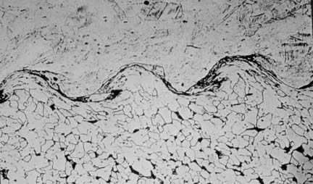

Slide 32
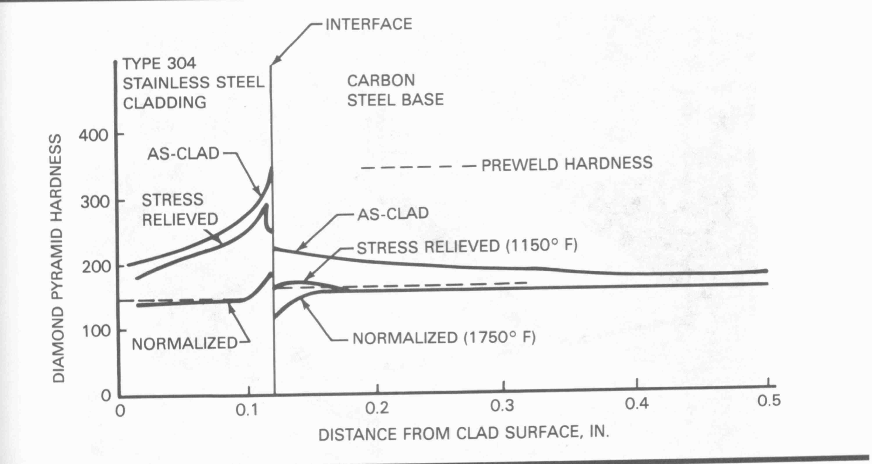
Courtesy AWS handbook

Slide 33
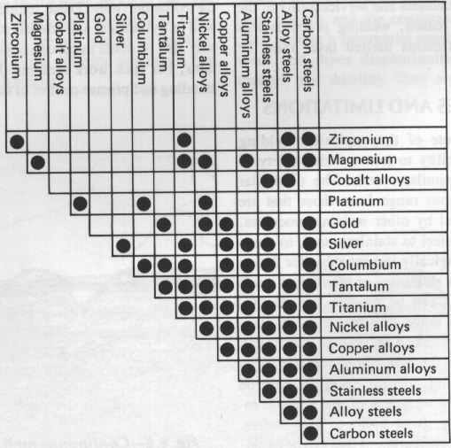
Typical metal combinations that can be explosion welded
Source AWS handbook

Slide 34
Applications of Explosion Welding
Any metal of sufficient strength and ductility can be joined.
Cladding flat plates constitutes the major commercial application.
Can be used to clad cylinders on inside or outside surface.
Transition joints can be made.
Tube to tube sheet joints in heat exchangers.
Notes:
As a general rule, any metal can be explosion welded if it possesses sufficient strength and ductility.
The cladding of flat plates constitutes the major commercial application of explosion welding. Aluminum clad steel plate was used extensively in the naval deck applications at one time. Explosion welding can also be used to clad cylinders on inside or outside surfaces. Tube to tube-sheet joints are made by explosion welding in heat exchanger applications.
Transition joints produced by explosion welding can be used for fusion welding dissimilar metals. A similar metal fusion weld can be made on either side of the transition joint.

Slide 35
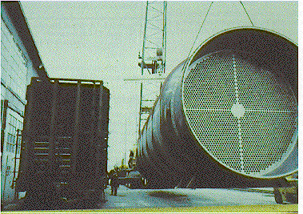
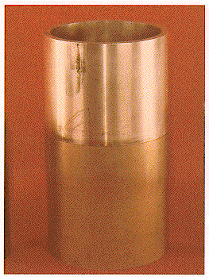
Finished vessel fabricated from explosion
clad plate.
Explosion welded 12 inch diameter
3003 aluminum to A106 grade B
steel tubular transition joint.
Courtesy AWS handbook

Slide 36
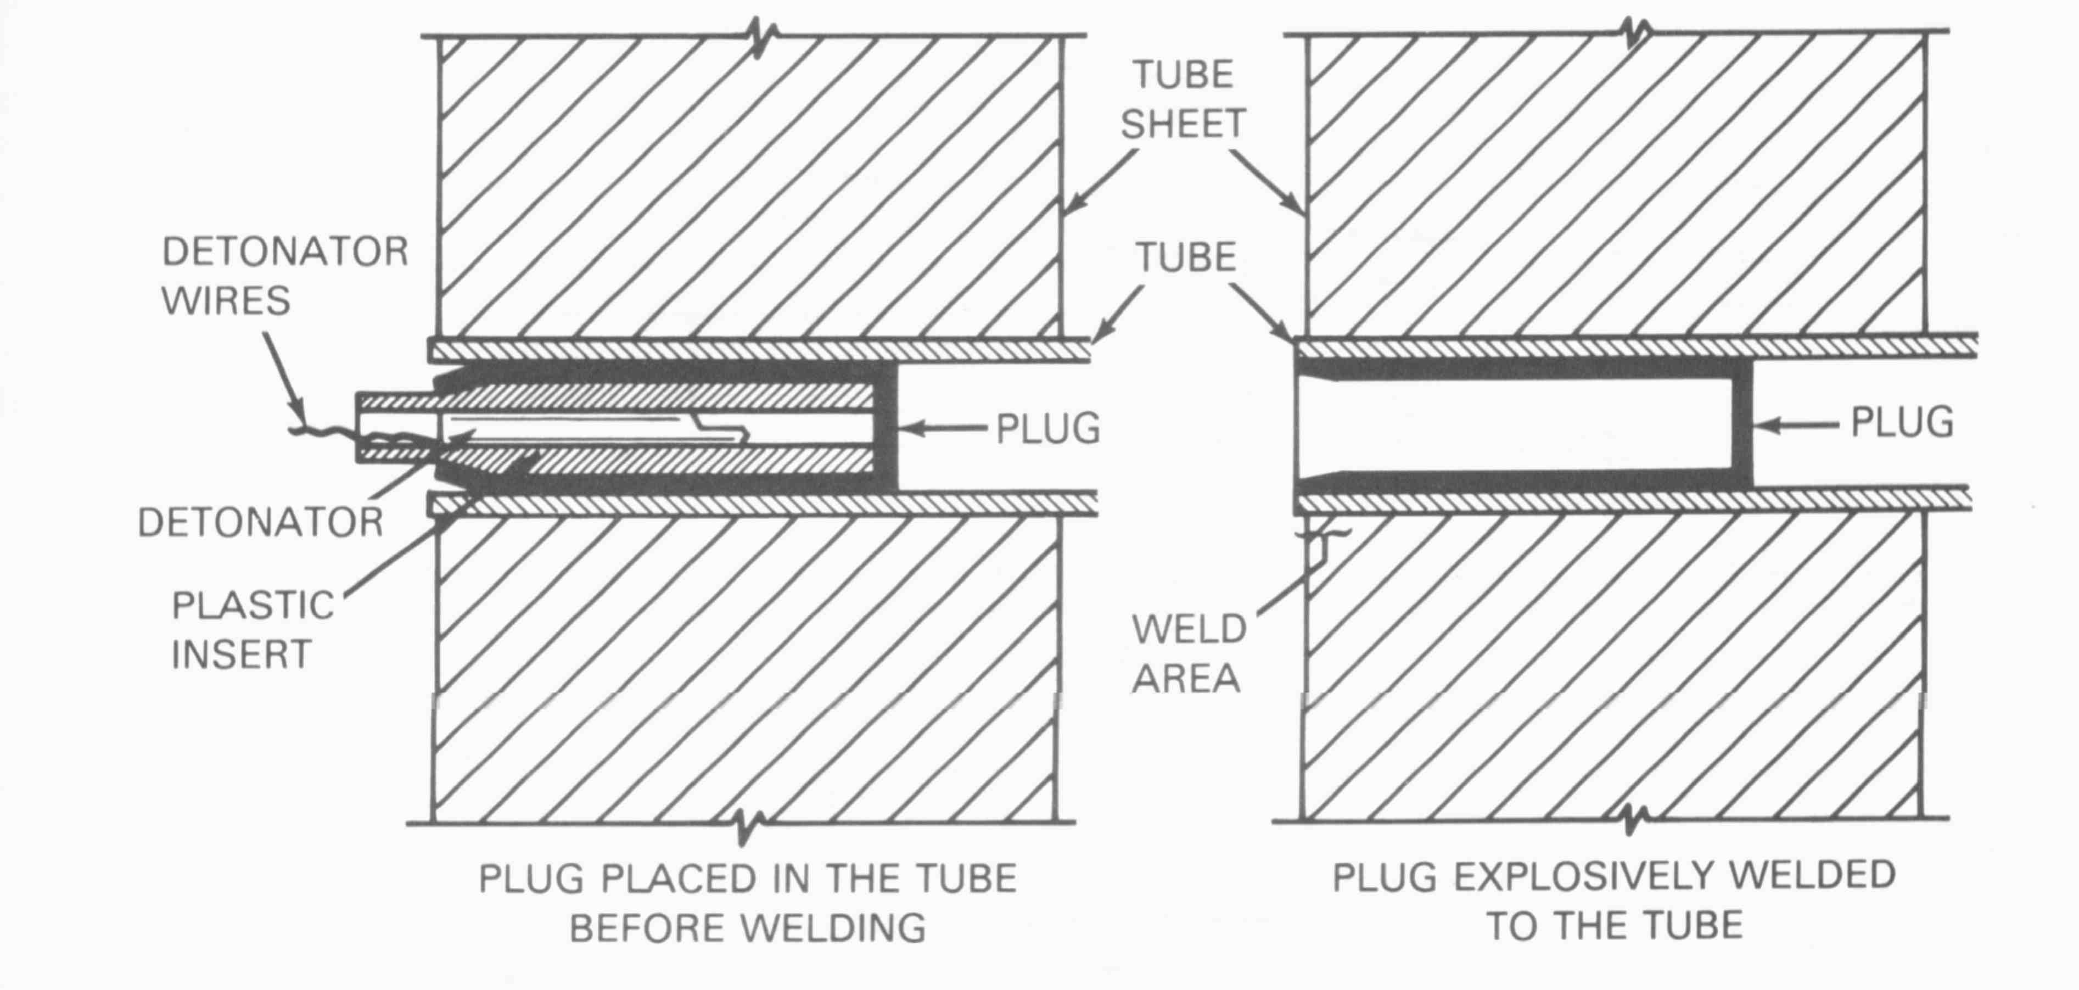
Plug Welding of a Tube within a Pressure Vessel Tube Sheet
Courtesy AWS handbook

Slide 37
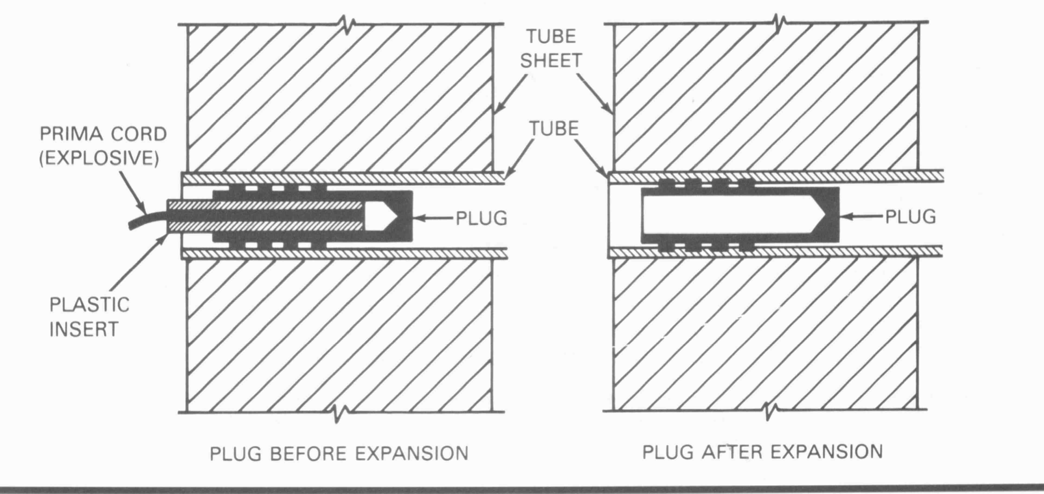
Using Explosion to seal mechanical plug
Courtesy AWS handbook

Slide 38
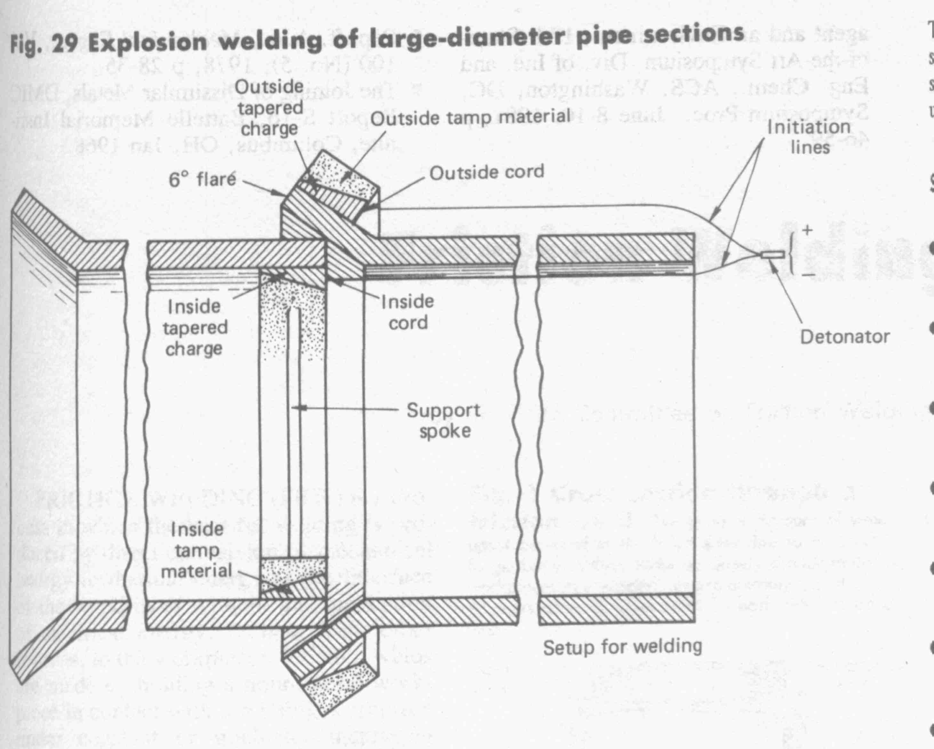
Metals Handbook, ASM, 1983

Slide 39
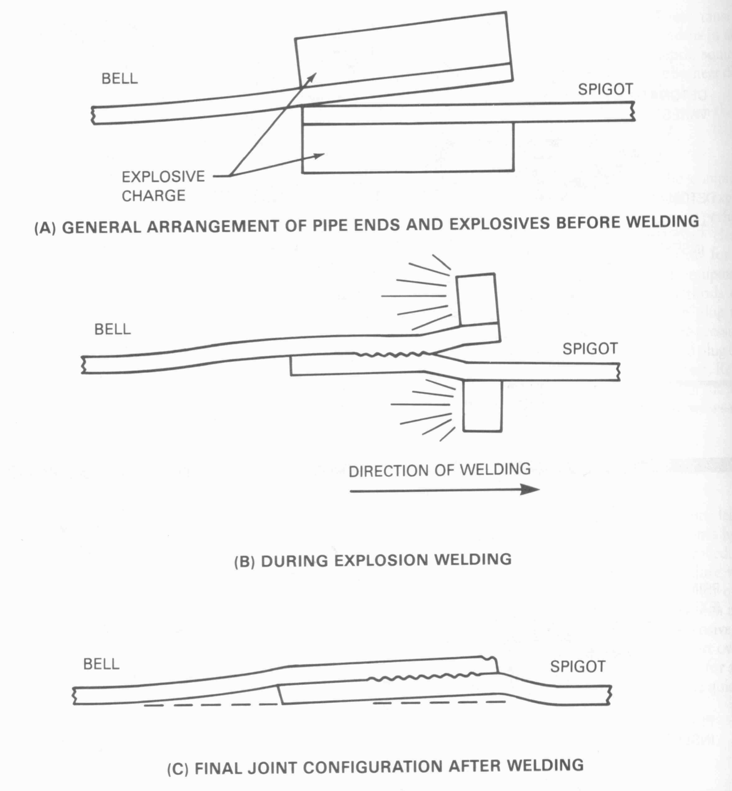
Explosive Pipe Welding
Courtesy AWS handbook

Slide 40
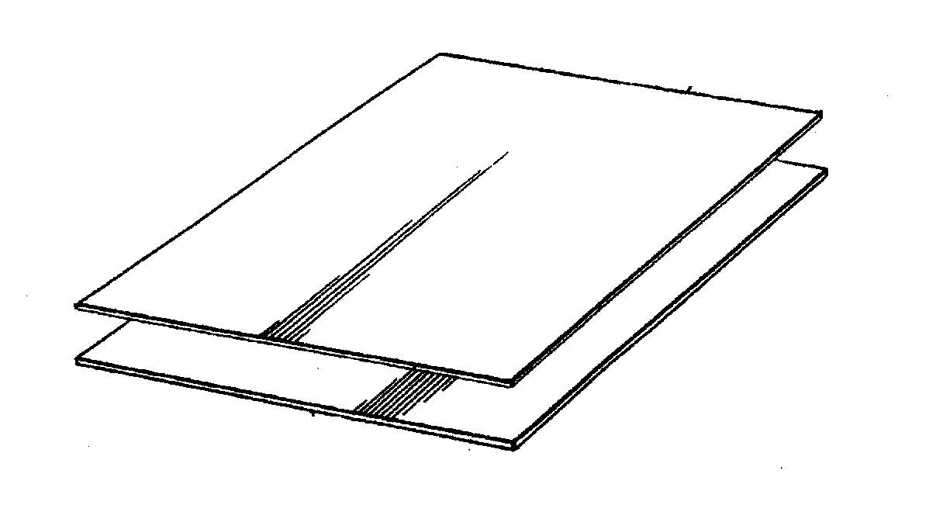
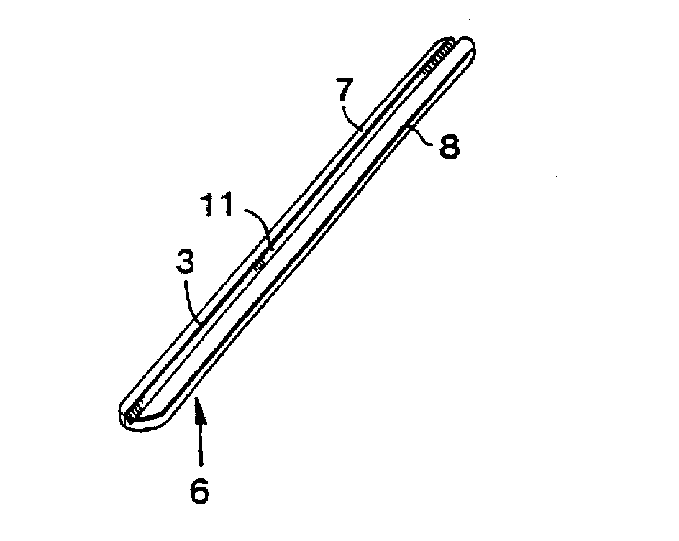
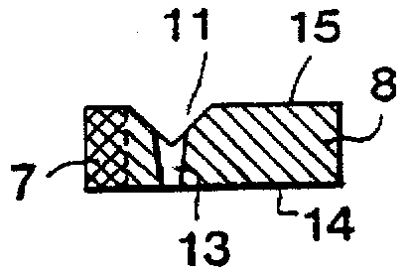
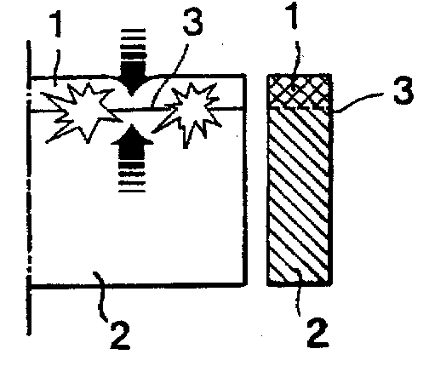
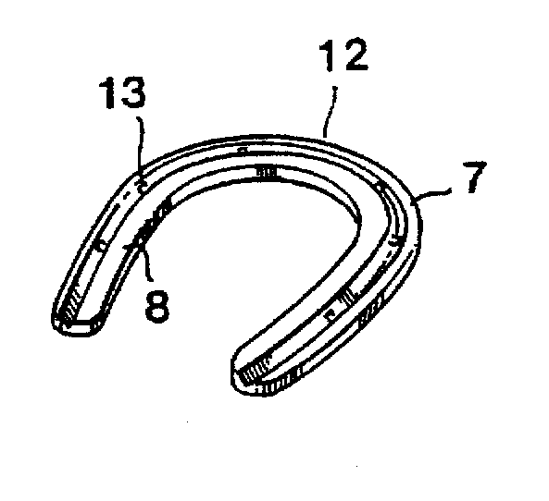
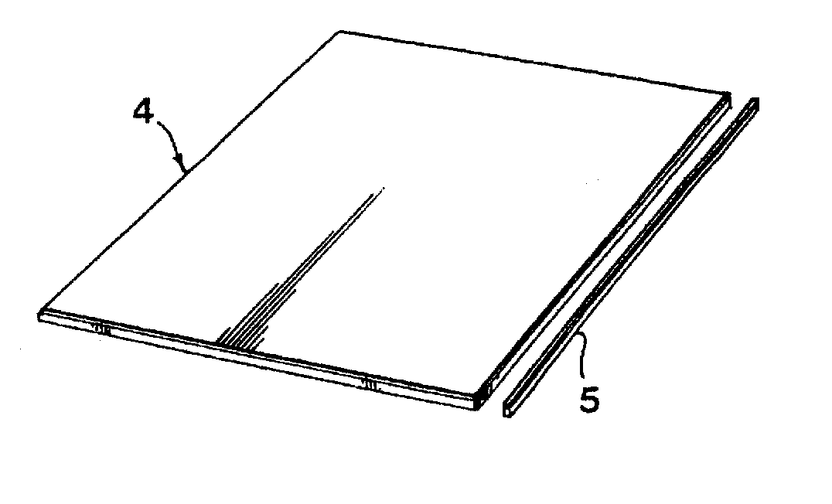
Explosion Bonding of Horseshoes
Insert Nail Groove & Hole
Thin Steel
Thick Aluminum
Steel
Explosion Welded
Aluminum
Cut Strip/width of shoe
Form Shoe
Backman, C “Method and a Blank for the Production of Horseshoes”, Patent 5,727,376 Mar 17, 1998
Notes:
In this example, a thin sheet of steel is explosively bonded to a thick sheet of aluminum. The steel gives wear protection, the aluminum gives light weight. A strip of the bonded material is cut the thickness of the final shoe and the nail roves and nail holes machined. The shoe is then bent into shape by the farriers.

Slide 41
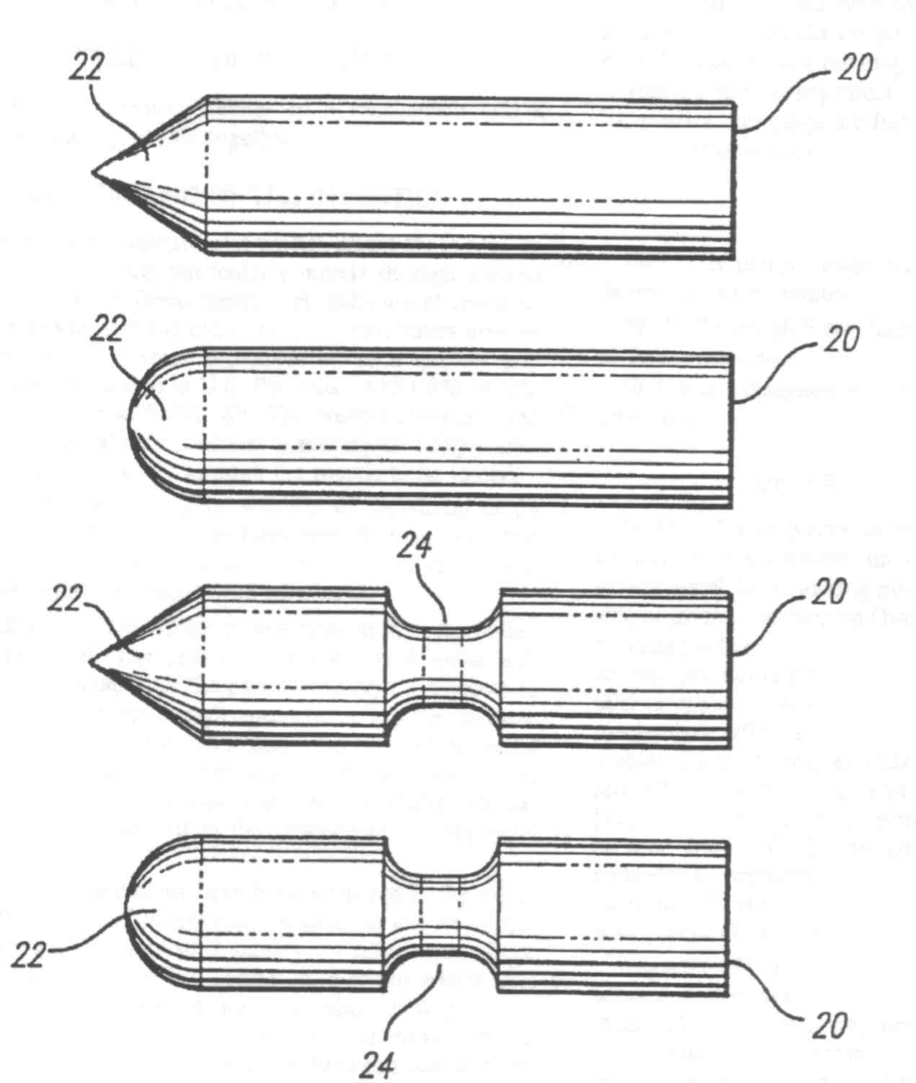
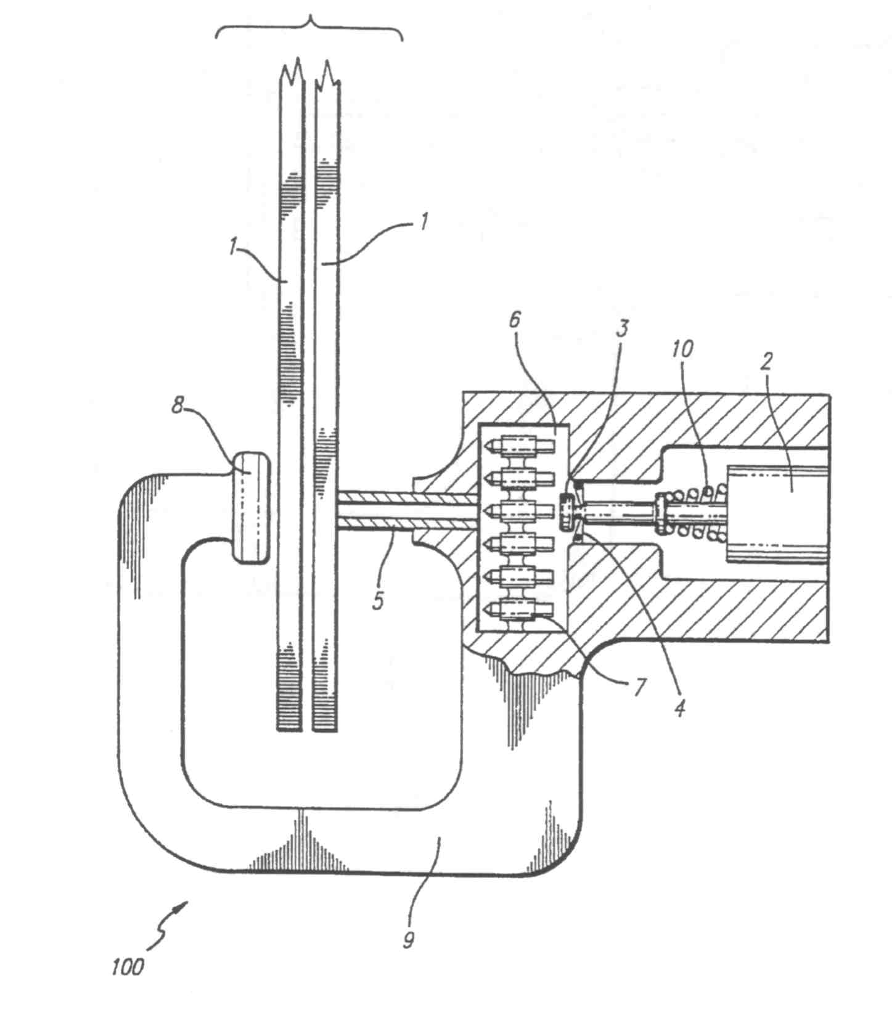
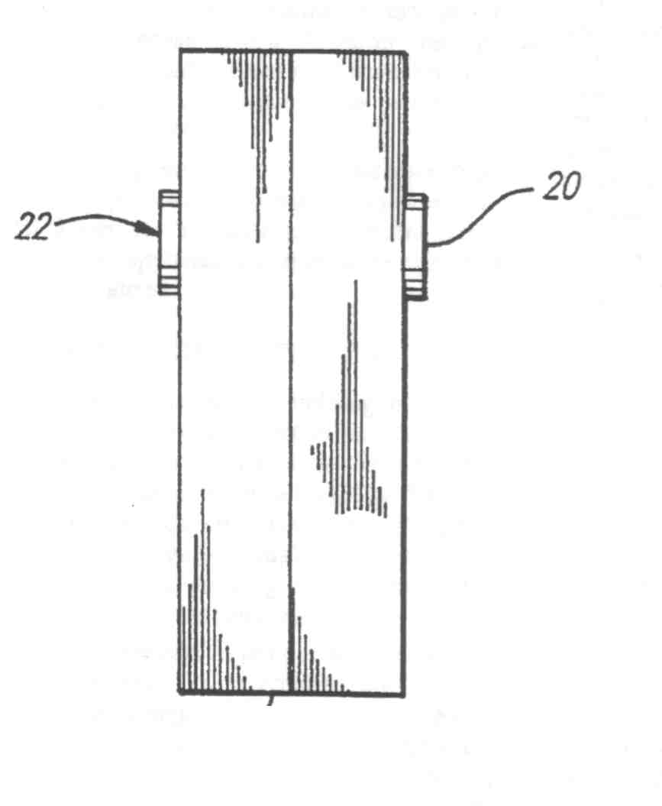
Projectile Welding of Aluminum
Multi-Molecular Nucleation surface between projectile of same material and sheets
Joseph, A., “Projectile Welding”, US Patent 5,474,226 Dec 12, 1995
Notes:
This is a method of joining materials by shooting a projectile partially through materials to be joined. The mechanical work and friction heats and bonds the surface of the projectile made from a similar material.

Slide 42
PROCESS SELECTION

Slide 43
Process Selection
Selection of solid state welding processes
depends on the following factors:
Performance of the welding processes under existing conditions
Advantages of the processes involved
Durability of the welds produced
Materials to be welded
Economic viability of the process

Slide 44
Advantages of Solid State Welding
Eliminates liquid phases
Makes the joining of many dissimilar metal combinations possible
Can be performed with little or no deformation in some cases
Can be performed at very low temperatures in some cases
Some solid state processes can weld large areas in a single welding operation
Some processes are relatively rapid

Slide 45
Advantages of Solid State Welding
Eliminates liquid phases
  Example: cold welding, friction welding, ultrasonic welding, diffusion welding and explosion welding

Slide 46
Advantages of Solid State Welding
Makes the joining of many dissimilar metal combinations possible
  Example: friction welding, explosion welding, diffusion welding.

Slide 47
Advantages of Solid State Welding
Can be performed with little or no deformation in some cases
  Example: diffusion welding

Slide 48
Advantages of Solid State Welding
Some solid state processes can weld large areas in a single welding operation
  Examples: diffusion welding and explosion welding

Slide 49
Advantages of Solid State Welding
Some solid state welding processes are relatively rapid
  Example: ultrasonic welding, cold welding and friction welding

Slide 50
End of Lecture 14

